Slide 1
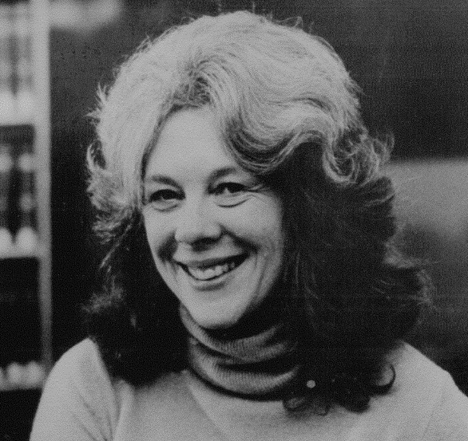
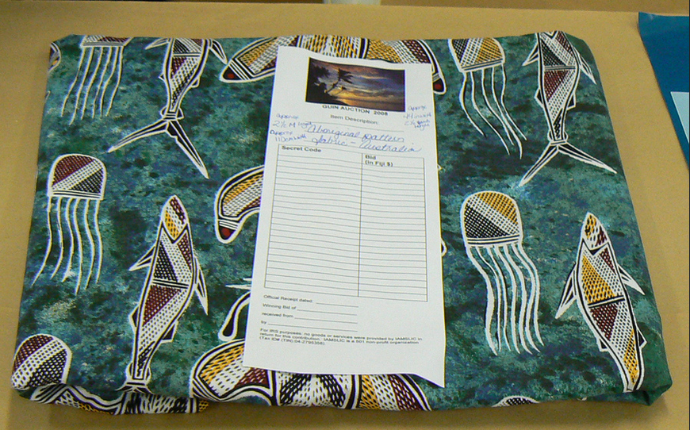
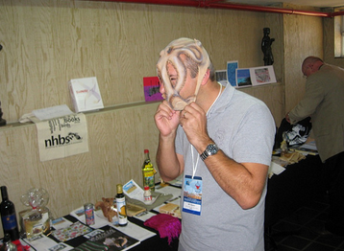
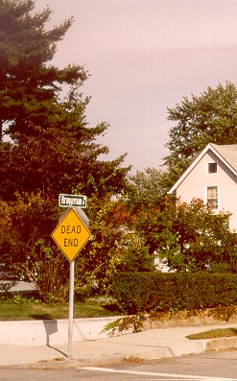
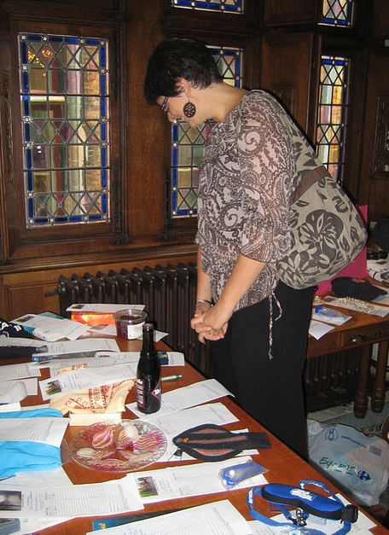
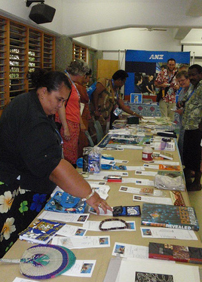
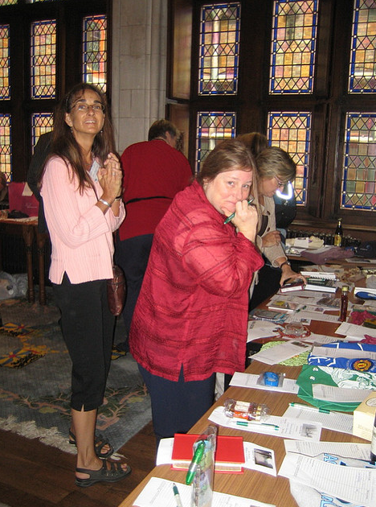
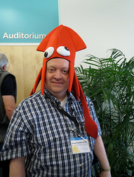
Guin Auction
Marilyn Potts Guin
1944-1989
Marilyn Potts Guin was the Head of Oregon State University’s Hatfield Marine Science Center library from 1975 until her death in 1989. The library is now named in her honor.
Chocolate, books, alcohol, fabric, local crafts and silly hats are always popular. Even a murder mystery featuring Peter Brueggeman showed up one year. Bid early, bid often!
Crossroad
to
Murder
Marilyn was a dedicated IAMSLIC member and devoted to international colleagues. The Guin Fund was established in her honor in 1990. Members may donate to the fund directly or contribute items to the Guin Auction held in conjunction with the annual international conference. Funds from the auction are used to assist members from developing nations attend annual IAMSLIC or regional group conferences. There are secret names, bidding wars and it is not uncommon to raise over $1,000.00 US per year.
Photos courtesy of Sally Taylor, Steve Watkins, Lenora Oftedahl and Inidepianas via Flickr.
Poster by Barb Butler

