Slide 1

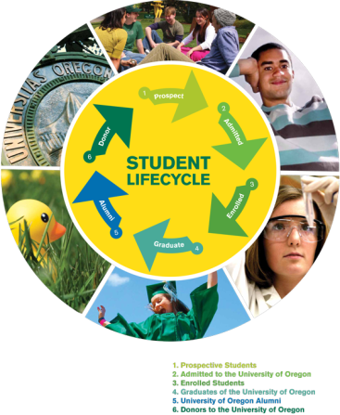
Creation and Implementation of an Alumni Recruiter Program
Kelly Talbert
University of Oregon College of Education
March 13, 2012 EDLD 655
Goal: To increase and broaden the partnership with UO alumni and Office of Admissions to assist the UO in reaching its enrollment goals. Benefit from the experience and enthusiasm of alumni to attract diverse, highly-qualified prospective students.
Proposed Plan
The plan is for the Office of Admissions at the UO to hire an Assistant Director for Alumni Recruitment, who will be charged with creating and developing an alumni recruiter program. Alumni recruiters are volunteers who engage in a number of activities aimed at connecting with prospective students who are high school juniors and seniors.
The person in this position coordinates the alumni student recruitment program and acts as Office of Admissions liaison with the UO Alumni Association. The person in this position also serves as a general student recruiter through recruitment territory management, advising prospective students and answering phone and e-mail inquiries. This person represents and recruits for the University of Oregon by traveling in-state and out-of-state to meet the enrollment goals of the university.
Justification
The number of applications for undergraduate admission has increased by 100% since 2007. The size of the recruitment staff has remained the same during that same period. Many of these students do enroll, as the graph below illustrates.
Universities are increasingly interested in leveraging the enthusiasm of alumni to recruit students; alumni can become the “eyes and ears” of a college when budget cuts affect the amount of recruitment travel it can do (Scully, 2009). However, the size and scope varies greatly, as these programs are more costly and time-consuming than they initially appear (Fogg. 2008). These programs take time to develop, and must be carefully orchestrated (Buster Williams, 2008).
At the UO, The Vice Provost for Enrollment Management supports this position, the technological infrastructure exists, and there is a healthy relationship between Admissions and other key offices. Conditions exist for this program to be successful with the proper investment.
Implementation Timeline
Phase One (begins April 2012)
Learn the fundamentals of college admissions, recruitment cycle, etc.
Publicize program at spring events (receptions, UOAA Spring Board Meeting) and connect with key stakeholders
Research and decide on technical structure/framework for training
Research best practices for literature, communication plan
Phase Two (begins June 2012)
PD: Participate in Annapolis Institute
Identify, recruit and train a group of alumni who will participate in the following forms of new student recruitment:
High school visits in alumni student recruiters’ home areas
Personalized communication with prospective students
Deliver recruitment materials to local high schools
Represent the University of Oregon at college fairs
Conduct informational interviews in alumni student recruiters’ home areas
Phase Three (begins May 2013)
Evaluate activities and adjust as needed
Deepen activities and connections between alumni and regional recruiters and community-based organizations working with traditionally underserved students
Begin strategic vision for year two
Evaluate assigned recruitment territory
Budget & Staffing Needs
Salary $45,000
Travel $5,000
Table Banners $2,500
Print Materials $500 Alumni Reimbursements $500
Annual “thank-you” gift $400
Total FY 2012 $53,900
Other opportunity costs will be associated with IT staff time setting up and maintaining online training tools, as well as other recruitment staff time in training and connecting with alumni when they travel to their assigned recruitment territories in fall and spring, as well as other key points in the recruitment cycle.
Outcomes/Success Measures
Increase in the number of high school visits, college fairs, and individual contacts with prospects, applicants and admits
Increased collaboration with communication and events with UOAA
Increase in the value of admitted student receptions and other events due to alumni role, personal connection
Long-term: positive feedback from alumni that may lead to other kinds of support through access to facilities for events, donor support, etc.
References
Buster Williams, K. (2008). Using alumni to recruit at Old Dominion University. Recruitment and Retention in Higher Education, 22, 3-4
Piper, F. (2008). How colleges use alumni to recruit students. Chronicle of Higher Education, 54, 13-14
Scully, M. (2009). Meet the next generation. Currents, 35, 16-21

