Slide 1
Creating a Cosmology for
Information Literacy
Presentation by
John Russell

Slide 2
What is a rhizome?
From Deleuze & Guattari, A Thousand Plateaus [Mille plateaux]
Based on principles of CONNECTION, HETEROGENEITY, and MULTIPLICITY
Using these principles, we can create a system that values the multiplication of connections

Slide 3
What is a rhizomatic resource?
Anything that creates connections to other resources
Resources can be more or less rhizomatic
Just because something is less rhizomatic does not mean that it is useless

Slide 4
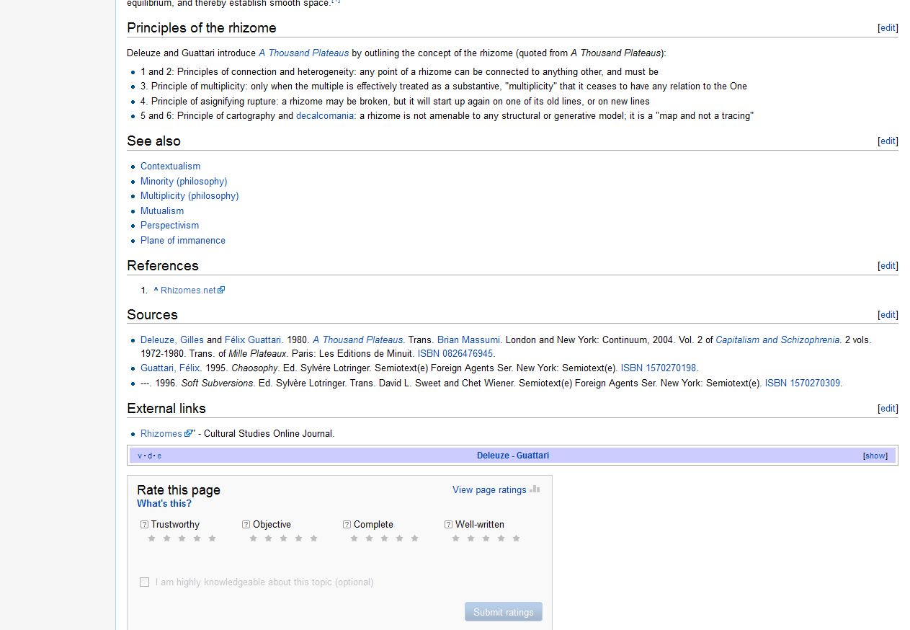
Example

Slide 5

Example 2

Slide 6
Moving in the Rhizomatic Universe
When we research, we can engage in a few different movements to locate bibliographic objects:
  Peripatetic: horizontal movement from resource to resource (searching in an encyclopedia, then in the library catalog, then in a database, etc.) to collect articles/books

Slide 7
Rhizomatic Universe, cont.
  Chthonic: vertical, “downward” movement within a specific article (mining footnotes, endnotes, a bibliography) to identify articles/books
  Hieratic: vertical, “upward” movement from a specific article to the sacred sphere of being cited by other books/articles (citation indexes, “Cited by” function in Google Scholar)

Slide 8
Rhizomatic Apocalypse
Every cosmology needs an apocalyptic element. For the rhizomatic universe, this element is the PUNCTUM.
A punctum is a point from which little or no movement is possible, a bibliographic object that lacks capacity for multiplying connections.

Slide 9
Rhizomatic Apocalypse
The punctum can exist objectively or subjectively, though an objectively existing, absolute punctum is unknown in nature.
Think of the punctum as an asymptotic concept.

Slide 10
Our Cosmology Mapped
Hieratic
Punctum
Peripatetic
Chthonic

