Slide 1
Leaving the Big Deal: Consequences and Next Steps: The University of Oregon Experience
North American Serials Interest Group
June 3, 2011
David C. Fowler

Slide 2
University of Oregon
Founded in 1876, the University has 263 academic programs and another 33 research centers and institutes.
2010/11 FTE enrollment is 23,389; 19,534 undergraduate students and 3,885 graduate and doctoral students.
Student body comes from all 50 states, and 85 foreign countries.
Division I athletic programs in 9 men’s and 10 women’s sports.
Notes:
Asian and Pacific Studies; Ecology and Evolutionary Biology; Women in Society; High Energy Physics; Sustainable Environment; Neuroscience; Materials Science; Marine Biology
Fun fact: UO is the rare AAU institution with no med school, vet school or large Ag program; we have a law school, but is very multidisciplinary.
2) Huge enrollment increases in the last few years, esp. from California; Has been straining the undergraduate infrastructure.
3) Western states contribute the most students esp. OR, CA, WA and AK.
Other top states: AZ, CO, HI, ID, IL, MA, MN, NV, NY, TX, UT.
Many Canadian students, esp from BC; Also Australia, China, France, Germany, Hong Kong, India, Japan, Qatar, Korea, Saudi Arabia, Taiwan, Thailand, UK and Vietnam.
4) BCS championship has created greater awareness of the Duck brand.

Slide 3

UO Libraries
Consists of Knight Library, Jacqua Law Library. Science Library, AAA Library and Portland Library and Learning Commons.
74 faculty, 85 classified staff, 58 student workers.
3,138,936 books and serials.
4,198,103 microforms.
783,154 maps.
1,327,009 slides and photos.
Notes:
1) All units come under the UO Libraries, though Law Library is dually administered with the Law School.

Slide 4
UO Libraries
291,531 electronic books.
74,487 current serials.
2,468,633 full-text downloads.
361,809 circulations of physical items.
Total budget of $20,042,433.
Materials budget of $6,427,158.
Member of Greater Western Library Alliance (GWLA) and the Orbis-Cascade Alliance.
Notes:
5) UO was recently ranked 95 in Total ARL expenditures. (About $7m below the median ARL level)
6) Gradual increases since 1999 with a slight dip in mid 2000s, followed by a large increase around 2008, following by the cuts of 2008-09. Have not kept even with general inflation costs.

Slide 5

The economy in 2008-09….
UO was hit, like most schools, by the big economic downturn…
Notes:
After an unusually flush budgetary period, we suddenly had to grapple with cuts.

Slide 6
Our economic situation, the facts:
University of Oregon has historically been neither a very rich or very poor public university.
Oregon ranks 43rd in the amount of state spending per student at public universities.
Over the years it has, by necessity, weaned itself off public funding.
The State of Oregon now provides less than 10% of UO’s funding.
Notes:
As a result, the university, has learned to do more with less, and has developed a “mean and lean” ethos, taking pride in its ability to accomplish much with far fewer resources than many of our ARL comparators.
-
The UO’s current president, Richard Lariviere is proposing to the State Board of Higher Education plans that would stabilize the school’s finances during rising a falling state budget cycles by issuing $1 billion in bonds to operate the school for the next 30 years and that would establish UO as a separate government corporation that would manage it’s own budget without being dependent on the Legislature.
This number has been shrinking gradually of the years, causing people to remark that UO is a “state university in name only.”

Slide 7
Cuts at UO:
Due to the 2008-09 economic downturn and other budgetary pressures, the UO took a 20% cut in state funding in that biennium.
The University recently raised tuition by 7.5% to help bridge the gap in 2010. It is going up another 6% in 2011.
The University Foundation has worked to raise $853,000,000 in new donations and pledges to help bolster its endowment in the last two years.
Notes:
The remaining 90+% is received from private gifts, research grants and student tuition.
An additional 7% cut has recently been instituted before the end of FY09 to cover projected state budget shortfalls.
2) -
3) However, because of state fund-raising rules, donations must be invested for several years, before we can begin drawing on the interest, and very large portions of the money have various stipulations on its use (athletics, construction, etc.)

Slide 8
The Library Budget Crisis, Background:
Similar cuts to what the University absorbed impacted the library initially.
Dating back to the last serials cancellation project in 2003-05, the library worked to eliminate as much format duplication as possible.
However, serials inflation was gradually catching up with the savings previously achieved, as illustrated here:
Notes:
The provost exempted the library from certain cuts, however, and charged our portion of some cuts to central administration.
The library budget was able to coast on the savings created by these actions for several years, without having to worry about materials budget deficits.
Projections showed a modest deficit occuring, beginning in 2008-09, and growing rapidly after that.
Adjustments to the collections budget in the last decade have swung from +2.75% to -2.75%, which is not huge, but which certainly does not cover inflation.

Slide 9
Notes:
This slide illustrates the collections budget trend at UO from 1992 to 2009 (Light Green Line). It’s gone from about $3.5 million to a little over $5 million in that time.
We’ve remained well under HEPI Index (Upper Orange Line) since about 2002 and under the Portland CPI (the closest local large urban area) (Brown Line) since about 2005. HEPI: Higher Education Price Index
Monographs expenditures (Lower Orange Line) have risen by 19% overall, but have remained hovering in the $1 million range for the most part.
Miscellaneous collections expenditures (Lower Olive Line) have decreased by 23% overall, but have mostly hovered around $500,000.
The real story is the serials expenditure line (Middle Gray Line), which has risen by 89% (about $2 million) over this time.
The UO libraries executed five serials cancellation projects in sixteen years, cutting $2.69 million in subscriptions. In unadjusted dollars, the serials budget would have risen by nearly $5 million without these.

Slide 10
Library Issues and Problems
Journal prices inflate, on average, between 8 and 10 percent each year.
If we didn’t reduce the materials budget, our ability to purchase other collection items would be compromised.
Notes:
1) The provost has given the library budget augments periodically, but these are unpredictable, and no substitute for a consistent, programmed budget increase. These augments have ranged from 0 to 3% a year.
Our ability to purchase monographic items (New books, video, audio, some databases) would be steadily reduced and at an 8% serials inflation rate (around $350,000 a year), the book budget would eventually disappear.

Slide 11
Our Plan
Eliminate any remaining format duplication in titles.
Target high-cost/low-use titles.
And crucially:
Some of our “Big Deal” deals would have to be broken…
Notes:
1) This had largely already been accomplished, but any further print/electronic/microfilm duplication would be targeted.
2) This was key to reaching targets as rapidly as possible, while cutting the fewest titles. Usage statistics and pricing information fed into the 360 Counter tool were manipulated and cost-per-use (CPU) figures were developed and ranked.
3) -

Slide 12
Our Plan
Using 360 Counter, we took the 2007 and 2008 journal cost and usage statistics and determined the cost-per-use (CPU), and then ranked them overall and within their aggregator. This information was provided to subject specialists to help guide their de-selection decisions.
Notes:
360 Counter from Serials Solutions. At the time, we had a full time ER tech, would was able to regular harvest statistics and add cost data into the utility.
We found in many cases, our hands were tied because of Big Deals currently in place. We couldn’t make necessary cancellations without breaking some deals.

Slide 13
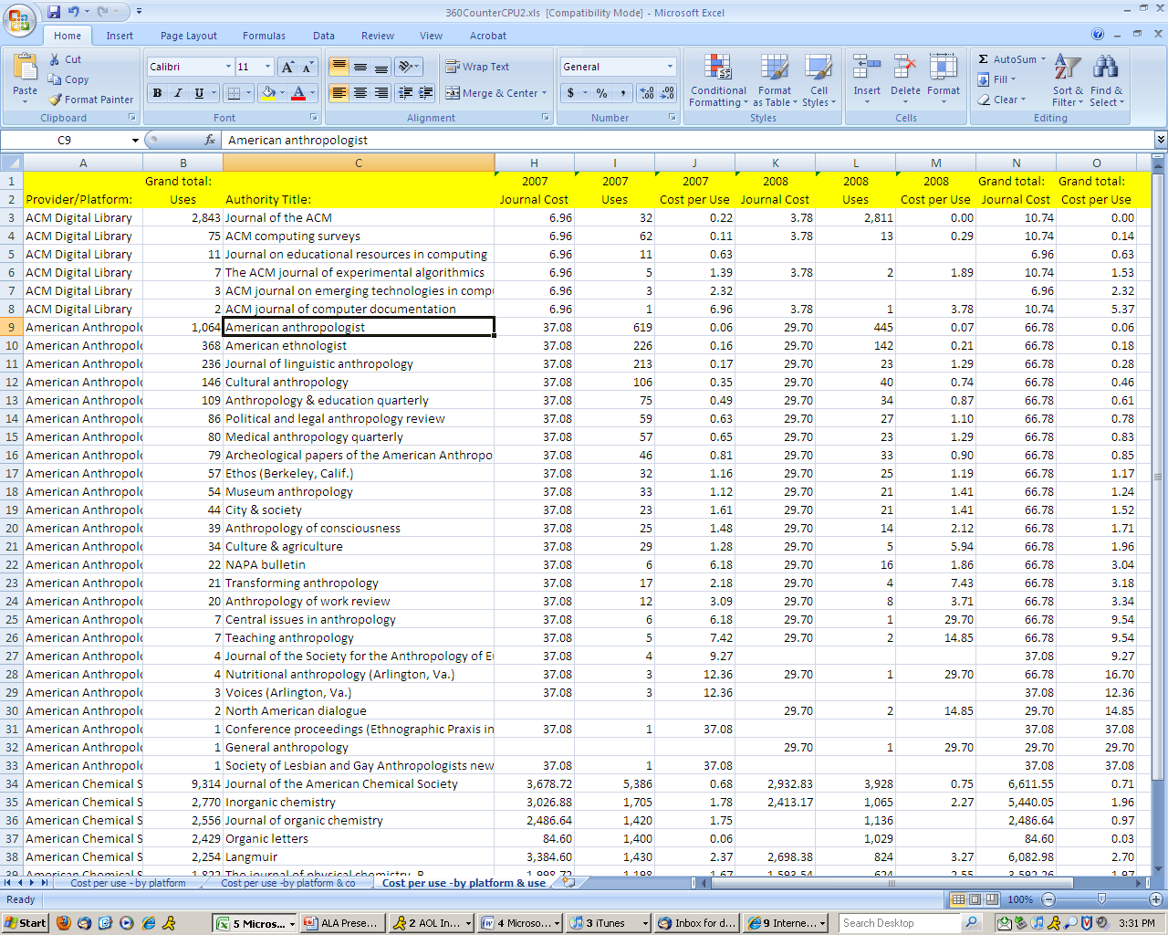
Notes:
This is an example of the spreadsheets we created that calculated CPU for most of our electronic journals.

Slide 14
Implementation - Elsevier
First, Pay-per-view access to Science Direct was rising at an unsustainable rate, and it was decided to cut this service.
The UO Collection Manager’s Group began meeting with their Oregon State University counterparts to look at general ways to collaborate on collection development in the future.
The biggest success from this effort was collaboration on a shared Elsevier collection deal.
Portland State University was later added to this particular initiative.
Notes:
This was initially offered as a partial solution to the loss of access in the previous serials cancellation project; Usage started off slowly, but eventually grew to the point of overwhelming any initial savings that were achieved from it.
In addition, there had been several instances of PPV abuse which had cost us many thousands of dollars and as we did not have the human resources to mediate it and Elsevier indicated it could not stop it when patterns of over-downloading occurred.
it was determined to bank the savings from this cancellation towards the larger budget.
2) The goal of these efforts was to reduce duplication of content between the schools (only 40 miles apart on I-5), thus enabling each school to purchase more books than they would be able to on their own, while relying on rapid-ILL to share resources between them.
Results have been mixed. ILL initiatives have been well-used, but CD collaboration seems to have stalled, due in part to differing collection philosophies, differing audiences and differences of opinion on how much duplication is necessary.
3) The previous deal, brokered by the Orbis-Cascade Alliance was too expensive for both schools and it restricted our flexibility to cancel an adequate amount of titles to be able to meet our overall goals.
4) Although UO-OSU planning for the Elsevier deal was fairly advanced, it was determined that adding PSU would enhance our cost-benefit ratio. In addition, PSU’s academic and research aims in many ways were more closely aligned with UO’s, than OSU’s were.
UO had already been on an interim 1-year deal that preserved Orbis shared access, but OSU and PSU had already signed multi-year deals, which they were required to break in order to enter into a new deal.
Over the summer and fall of 2009, three-way negotiations with Elsevier took place, and a new deal with shared access and a Unique Title List was brokered, which enabled each school to collectively maintain access to all titles that accounted for 90% of usage AND to meet their respective cancellation goals.

Slide 15



The Elsevier Deal
The previously-existing Elsevier deal covered the entire Orbis-Cascade Alliance (36 schools), not just UO, OSU and PSU.
Of the 3 schools in the new deal:
OSU: 55% of dollars spent
UO: 25%
PSU: 20%
UO required ~$58,000 in cuts.

Slide 16
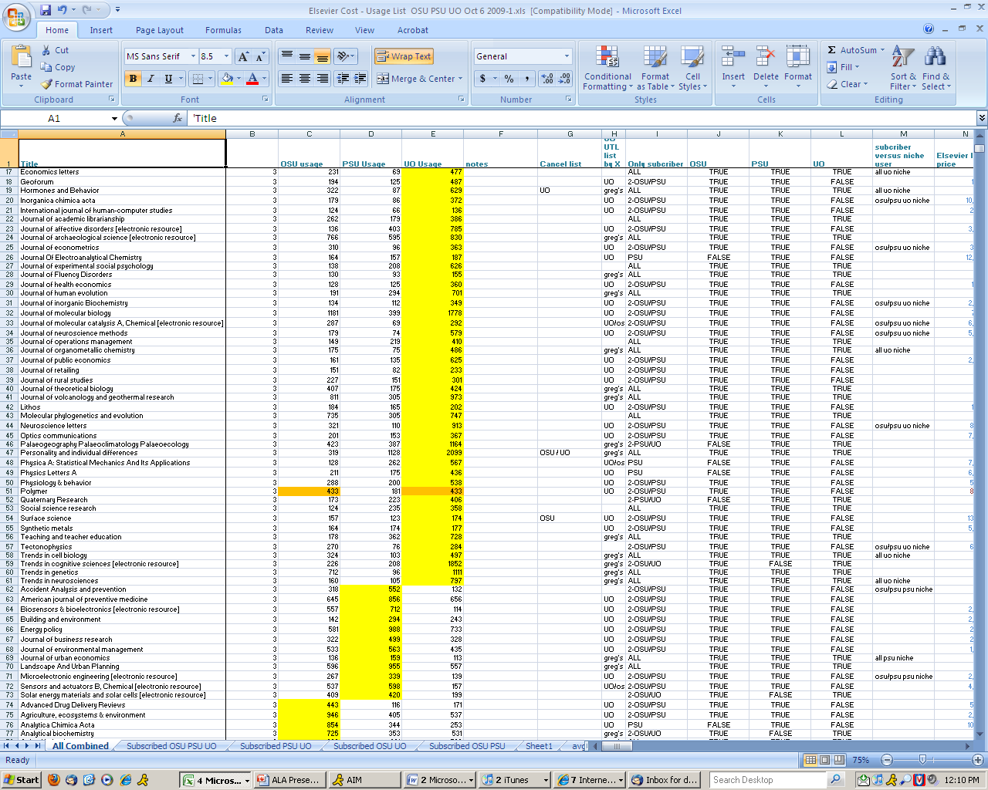
Notes:
This is an example of a spreadsheet created by Dean Walton, a science librarian at UO, that used an algorithm to measure combined use, cost-per use, Eigen factors, article influence rankings and whether or not a title’s usage was wide for all schools, or just for one (“niche”) and whether or not a title was in the highest 90% of usage ranking.
The goal was to include most or all, 90% usage titles.

Slide 17
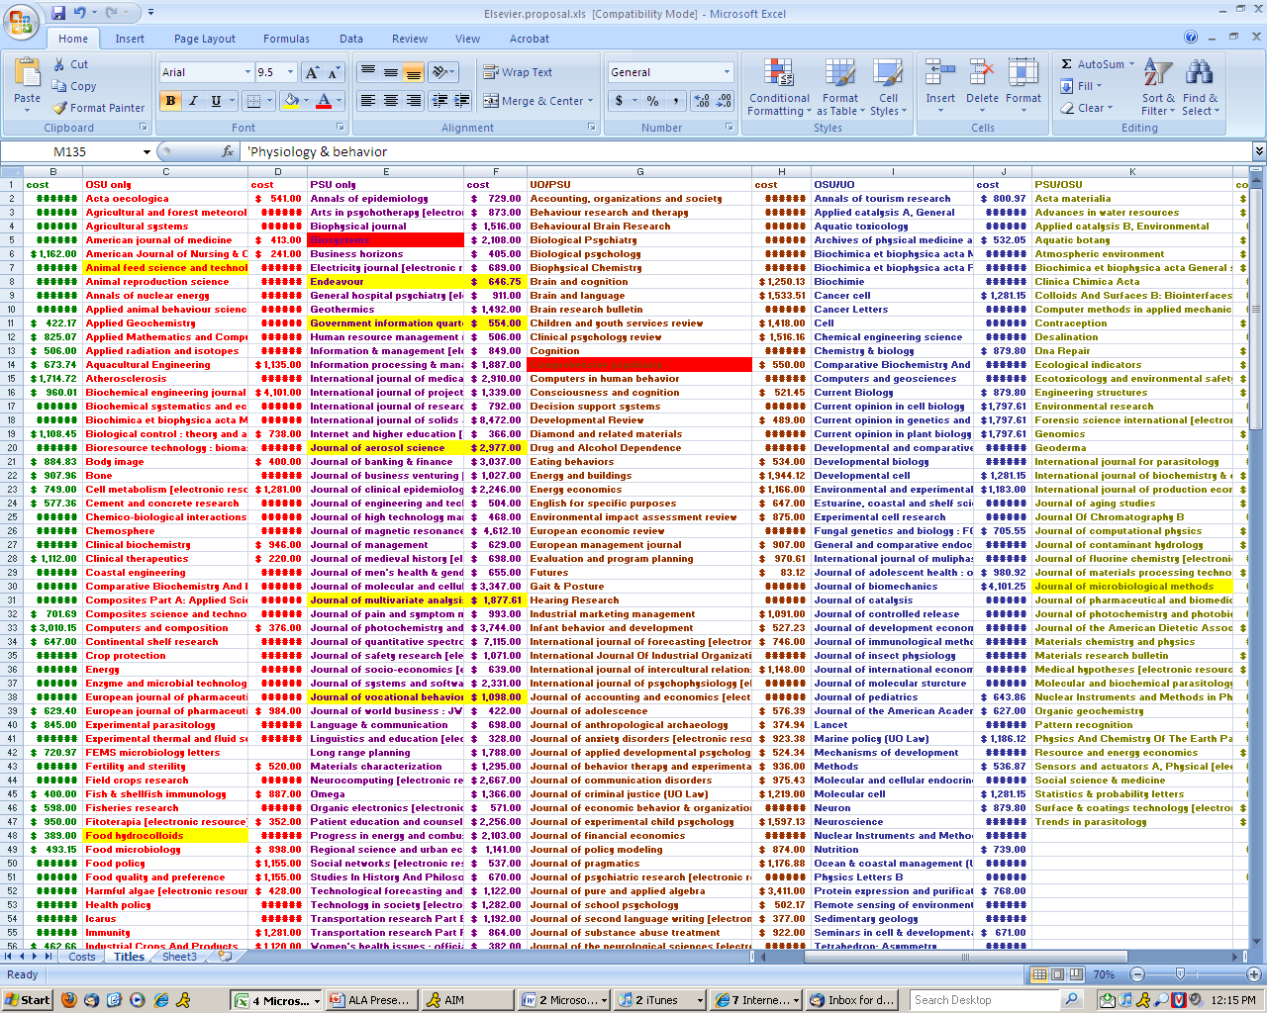
Notes:
This is the spreadsheet that we used to list out our final selected titles; Titles to be subscribed to individually, by UO, OSU and PSU; as well as shared titles that we would get for a discounted access price from Elsevier;
These were divided into UO-OSU, UO-PSU, OSU-PSU and “Big 3.”

Slide 18
Downsizing the Elsevier Deal
As soon as our intentions were made known, Elsevier asked for separate meetings with the 3 schools’ leadership.
We made it clear we would only meet together.
We initially needed a combined cancellation of 18% across all 3 schools.
Elsevier wanted us to hold cuts to 10%
We negotiated a reduced content fee, which enabled us to reduce cancellations to 14%.
Notes:
All schools interpreted this as am attempt at a “Divide and Conquer” strategy, and spurned it.
2) -
3) UO cuts: 17%; OSU cuts: 19%; PSU had a marginal spend increase. This was not feasible.
4) -

Slide 19
Downsizing the Elsevier Deal
Elsevier had presented a formal content fee offer of 25%
However, all 3 schools recorded a verbal 12.5% content fee offer from them.
OSU and PSU needed to be released from their current contracts as well.
UO was using a 1-year interim contract.
These terms did not include Cell Press titles.
Notes:
During negotiations….
2) Elsevier seemed surprised by this, but agreed.
3) UO had expected the need for flexibility coming, and had previously asked to extend the previous contract by 1 year.

Slide 20
Downsizing the Elsevier Deal
Elsevier then countered with two options:
A) 10% cuts,10% content fee, a UTL and sharing of titles; or:
B) 14% cuts,12.5% content fee, a UTL and no sharing of each other’s titles.
First option was rejected; We countered with full sharing for Option B and a 3 years of 0% increases.
Our counter was accepted except for the inflation request. (0%/2%/5%)
Notes:
UTL: Unique title list; Shared, non-subscribed titles obtained at a fraction of list price.

Slide 21
Elsevier Now
Schools opted for a 2-year deal.
We are reaching the end of the first-post-Big Deal deal.
Negotiations have re-started with Elsevier.
A brief attempt to re-offer the Freedom Collection was aborted by Elsevier.
Hoping to have a 3-5 year deal in place by summer’s end.
No major title adjustments.
Holds inflation to very reasonable levels.
Notes:
At the time, budgets were tenuous, and 3 years seemed too risky.
2) –
3) –
4) To their credit, they determined they could not make it financially viable for us; OSU and PSU especially were unentusiastic about that.
5) In the final stages of back-and-forth now.
6) All 3 schools quite pleased with Elsevier’s offers.

Slide 22
Elsevier Now
At UO ( not inc. Cell Press & Law School):
2009 (before cuts): $406,566.20
2010 (after cuts, year 1: $361,689.49 (-11%)
2011 (after cuts, year 2): $372,540.18
2012 (projected): $387,593.00
2013 (projected): $403,097.00
2014 (projected): $419,221.00
Notes:
By 2014, we will have surpassed where we were before the Big Deal was downsized.
UO serials budget expected to be able to keep pace to 2014. Unsure beyond that.

Slide 23
Elsevier Now – Impacts
A small uptick in ILL/DD requests.
Pre-selection of titles based on best cost-per-use seemed to mitigate most customer dissatisfaction.
No significant student concerns.
A moderate amount of faculty concern, due to the loss of certain STM titles, especially in Chemistry and Physics.
Considering a library-run PPV option for certain science disciplines, but may be some obstacles.
Notes:
Doesn’t seem to be anything beyond normal ILL increases.
2) We feel the blood and sweat that we invested in the beginning paid off well.
3) Have heard no significant complaints.
4) A few high-cost, low-use, but “important” titles were dropped; Some of the PPV cancellations’ impacts factored here.
5) Somewhat undemocratic, creating a 2-tiered system of access to information, based on discipline; Would library fund, or would the targeted departments fund?; Can Elsevier make it feasible technically, so that general public cannot access the PPV titles?

Slide 24
The Wiley Deal, Background:
Access to ~1,000 titles via the Greater Western Library Alliance.
Shared access to the majority via our GWLA partners.
Blackwell titles not yet fully integrated into Wiley, so two title lists to account for.
Many direct-from-Wiley titles.
The rest were split between EBSCO and Harrassowitz.
Notes:
A classic Big Deal arrangement.
-
3) –
4) Created an added element of uncertainty, attempting to normalize the two title lists.
5-6) Caused additional complications by having titles from multiple vendors.

Slide 25
Killing the Wiley Deal
Made 96 cancellations, worth $166,103 in initial cancellations.
Also, temporarily cancelled all other Wiley and Blackwell titles in 2009.
Re-ordered those desired/affordable in 2010:
278 titles, worth $353,513.
Several UO-OSU “shared titles” held by OSU, that we had to reinstate for UO.
Loss of 534 consortial titles from GWLA partners.
Notes:
-
Cancelled everything in order to meet renewal/cancellation deadlines.
Later re-ordered the titles we were certain we wanted.
Looked at usage stats, and selected the highest use/CPU titles overall, not just narrow UO titles.
Access gap will increase as we move forward in time.

Slide 26
Killing the Wiley Deal
Mini-deal with OSU considered.
Collection managers pretty battle-scared after long Elsevier analysis and re-negotiation.
It was determined that not enough time and energy remained to put together a second mini-deal.
Requested and received a single-institution “enhanced access license.”
Notes:
-
A lot of energy was expended, and not much time remained

Slide 27
Life, Post-Wiley
297 subscribed titles (+ 28 “comes with” titles).
Currently pay $380,852.03 for subscribed titles. (2011 “Core Collection” price + Anthrosource).
862 post-cancellation access titles, old title changes or freebies.
For P/C titles, access generally stops in Jan 2010.

Slide 28
Life, Post-Wiley
Blackwell titles integrated, as of January 2010.
Continue to find vendor transfers to/from Wiley.
In 2011, 4 transfers in (+$13,621).
In 2011, 4 transfers out (-$1,619.25).
Also seem to locate 1-2 print Wiley imprint titles annually that had previously been missed, which are added as e-titles.

Slide 29
Life, Post-Wiley
At UO (not including Anthrosource):
2009 (before cuts): $519,616.00 (approx)
2010 (after cuts, year 1): $351,567.02
2011 (after cuts, year 2): $379,315.03
2012: ?
Notes:
Still have a significant savings from this cancellation, going into 2012 and beyond.

Slide 30
Life, Post-Wiley
UO is generally happy with the results of the Wiley Big Deal cancellation.
We have adequate access to our highest-use titles.
Uptick in ILL/DD of these titles has been minimal due to the time spent at the front-end pre-selecting the titles that made the most financial sense.

Slide 31
Life, Post-Wiley
No blowback or noticeable complaints from faculty or students.
In retrospect, a non-event from the patron point-of-view.
We continue to do annual contracts with Wiley for subscribed titles only, and do not anticipate that changing.
Notes:
Analyses have shown that Wiley titles are not used as much as Elsevier titles, and the drop in access was not as critical for our researchers and students.

Slide 32
The Aftermath
We have maintained electronic access to our most-used titles, while shedding many high-cost, low-use titles.
We have a sustainable materials budget for the next few years.
Better than expected library income and some augments enabled us to indefinitely postpone the Year 2 serials cancellation.
Notes:
-
A new UO budget model is having a big impact on central services, like the library;
The library is in a unique position as an academic unit. We have non-discretionary costs that have not been systematically factored into the budgeting process, e.g. collections inflation, some labor costs. We also have costs that are clearly associated with increased enrollments.
To begin to address this long-standing problem, the university will be allocating a % of the matriculation fee directly to the library. All students pay what is called a matriculation fee which covers many incidentals such as orientation programs, transcripts, graduation costs, etc. Traditionally, five university units have received Matriculation Fee revenues, Student Affairs, Undergraduate Studies, International Affairs, Enrollment Management and the Graduate School. Beginning with FY12, the Library will be added to this list of units. The Library will receive 12.5% of the Matriculation Fee revenues. For fiscal year 2012, the projected increase is $278,000.
This does not preclude future adjustments to the library’s budget. It is a significant and first step towards a more rationalized method for funding the library.

Slide 33
The Aftermath
There is recognition that we, as a library, and as larger community cannot continue to business as usual.
Another cancellation project will be inevitable.
Notes:
We are encouraging faculty to be aware of their copyright retention abilities, and to spend time becoming familiar with journal pricing and inflation rates in their field.

Slide 34
Thank you.
Questions?
David C. Fowler
University of Oregon
dcfowler@uoregon.edu

