Slide 1
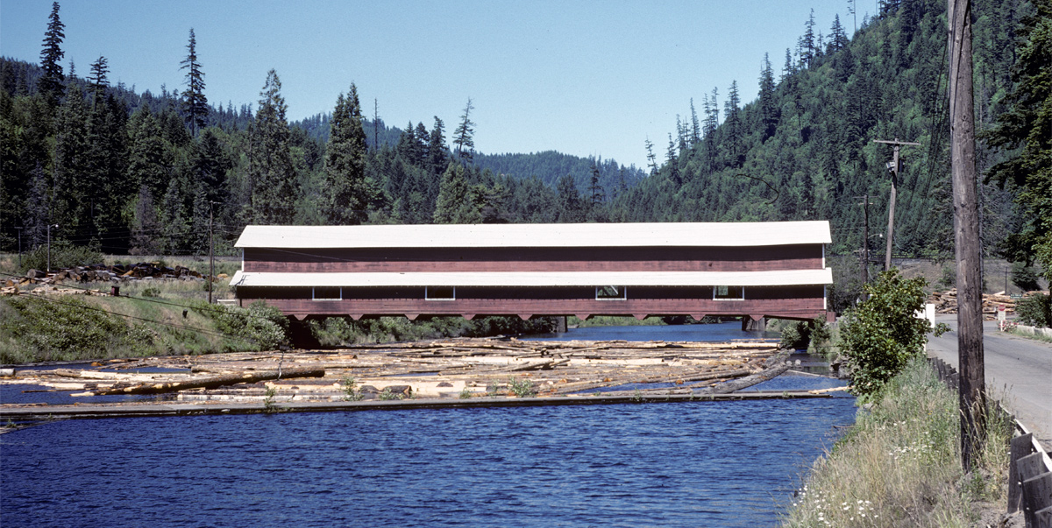
Building Oregon
A Closer Look at a Digital Collection
Notes:
When Karen Estlund announced that beta version of the Historic Oregon Newspapers full-text resource I was thrilled. I knew how valuable that resource would be in research architecture based upon my own studies, assisting others, and through my work creating Building Oregon. What is also interesting about the Oregon Newspaper Project is that the project’s own history is well documented. Besides architecture, one of my interests is local history, including the history of this library.
With over 19,200 records, Building Oregon is also an important resource in this architectural information network. Building Oregon describes 4,400 works of Pacific Northwest art and architecture representing 600 object types, created by over 1,150 architects, artists, and builders. Today I’m going to contribute to our library’s history by describing how Building Oregon was imagined and created, and along the way talk about some content in this resource, and other useful sources for studying Oregon’s built environment.
Note to readers: Descriptive information about images in this presentation including photographers can be found by consulting Building Oregon, http://boundless.uoregon.edu/digcol/archpnw/

Slide 2
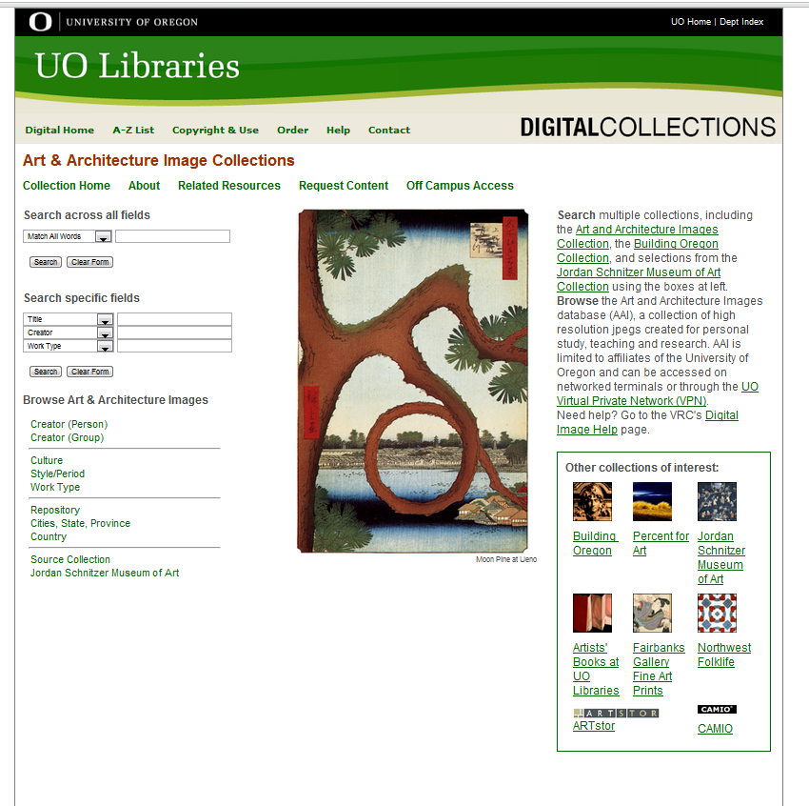
Notes:
In the 2005 planning process, I proposed two library initiatives in response to a growing demand from AAA for digital images as an alternative to slides. One initiative focused on the creation of digital images for classroom instruction which would be a restricted access collection built from copied or acquired content. The other focused on making a publicly accessible collection derived principally from the Marion Dean Ross and other slide collections housed in the Visual Resources Collection. The first initiative led to the creation in 2005 of a collection named Art & Architecture Images. It was initially comprised of acquired digital images and copywork associated with a course project. Today, under Julie’s guidance since 2006, the AAI now has over 100,000 records.

Slide 3
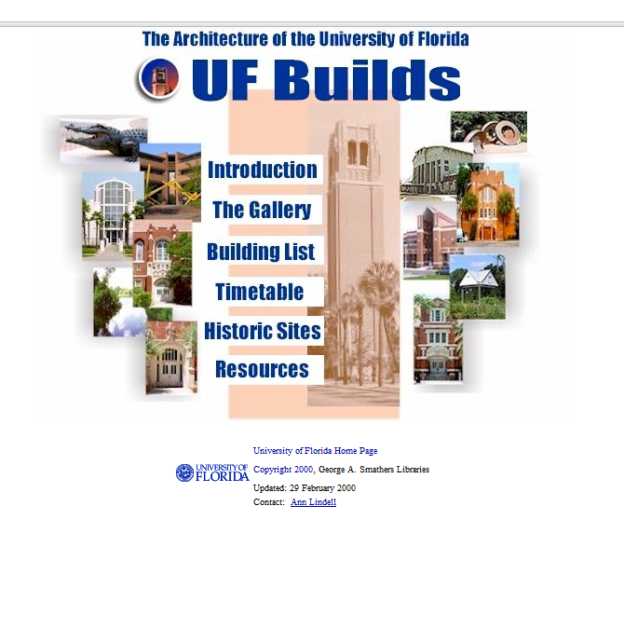
Notes:
The second initiative took a while longer to come to fruition. Developing the AAI was a priority, and there was no funding support for exploiting the gift slides for a new digital collection. Its concept became better defined as a resource focused on regional architectural work. The value of such an emphasis was inspired by the success of the guide to University of Florida architecture I created in 2004-05 (UF Builds). Inspired by a guide I created at the UF, the UO guide consists of over 100 pages of data, bibliographic references, and images. This guide and a concurrent library exhibit presented for the first time an organized visual construction of UO’s built heritage. What especially intriguing many was the description of demolished buildings, for example the structures that populated campus after WWII.

Slide 4
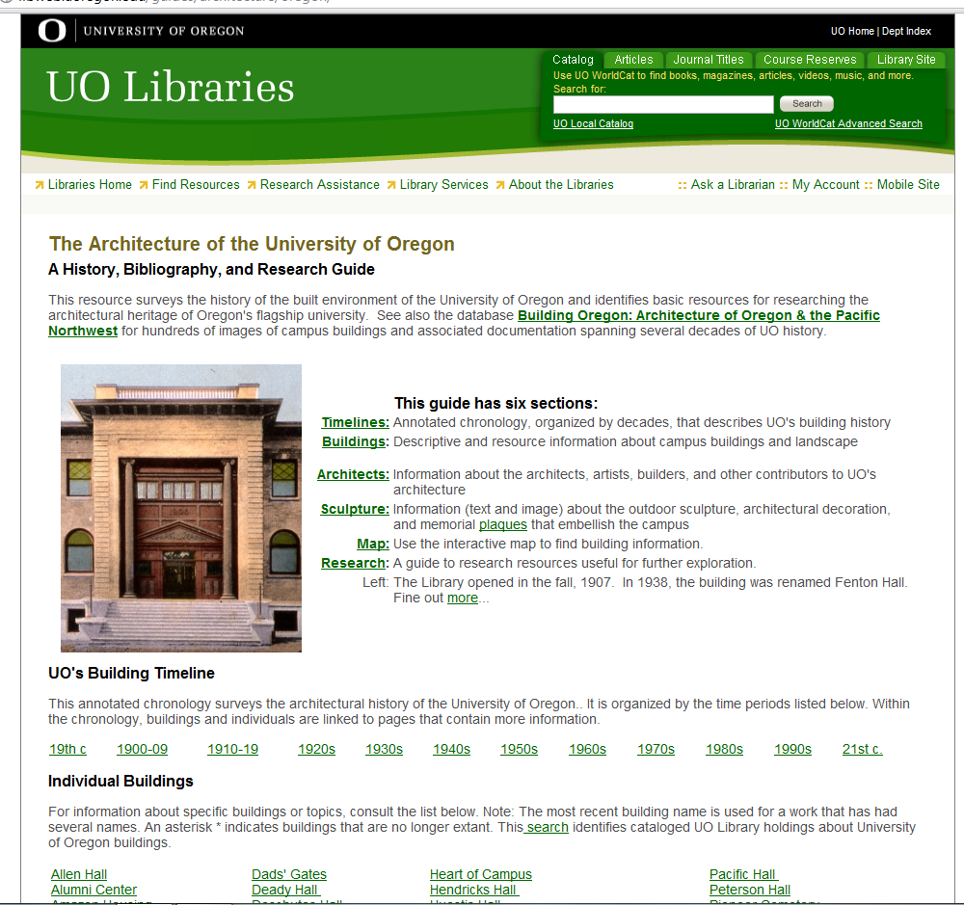

Slide 5
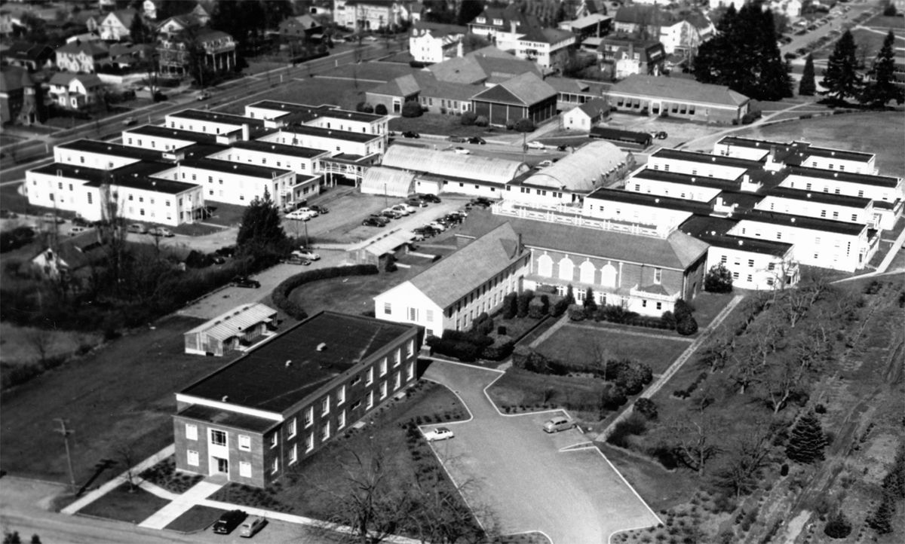
Notes:
Veterans dorms I, II, 1947, image 1951

Slide 6
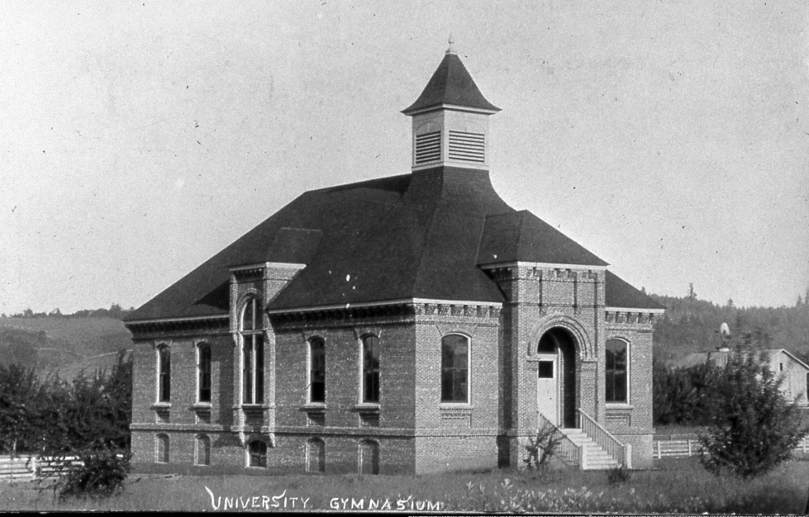
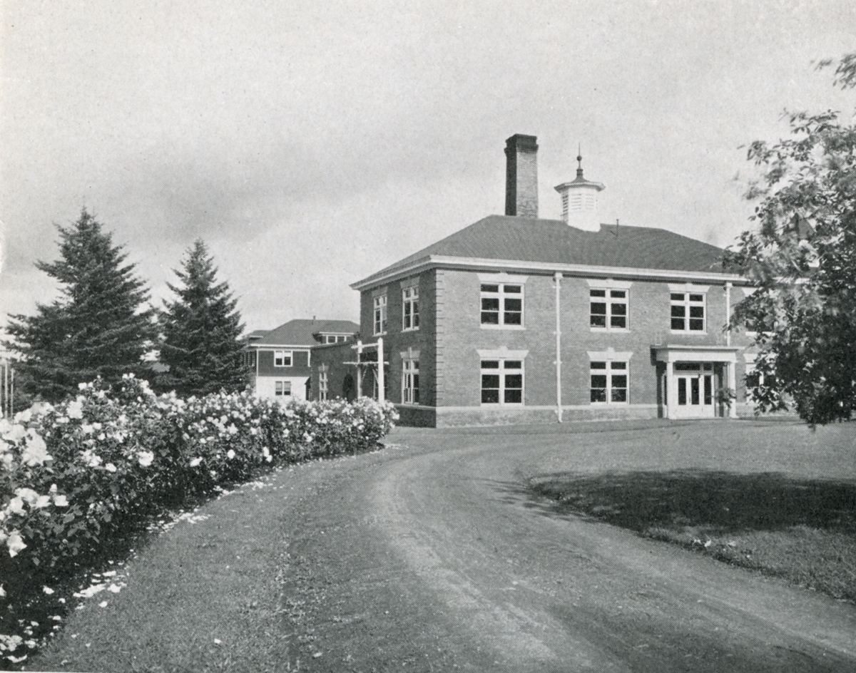
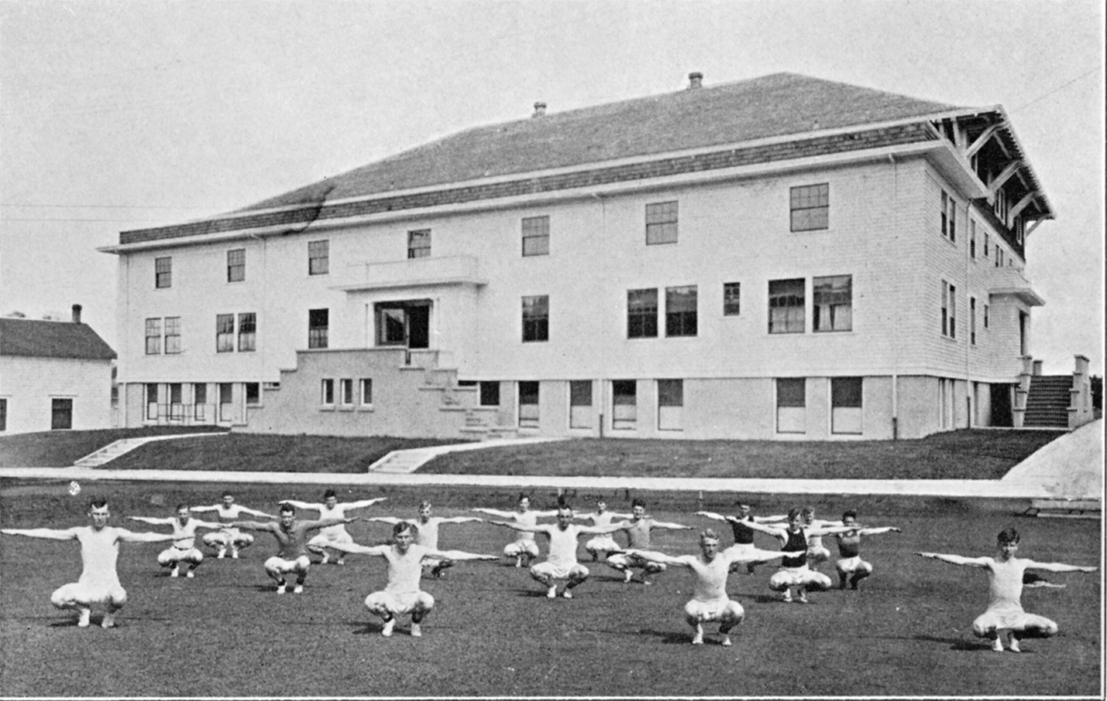
Notes:
1909 Gym
From Choosing a Calling (Eugene, Oregon: University of Oregon, 1913), p. 13

Slide 7
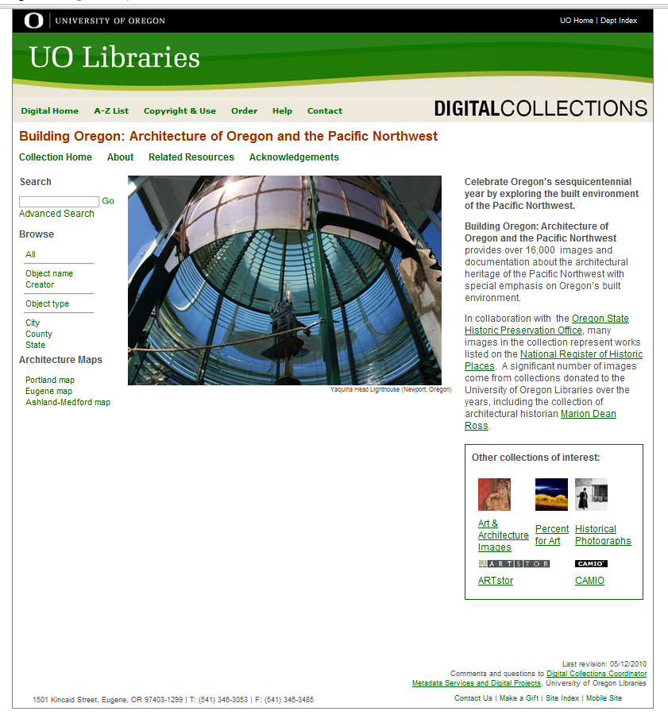
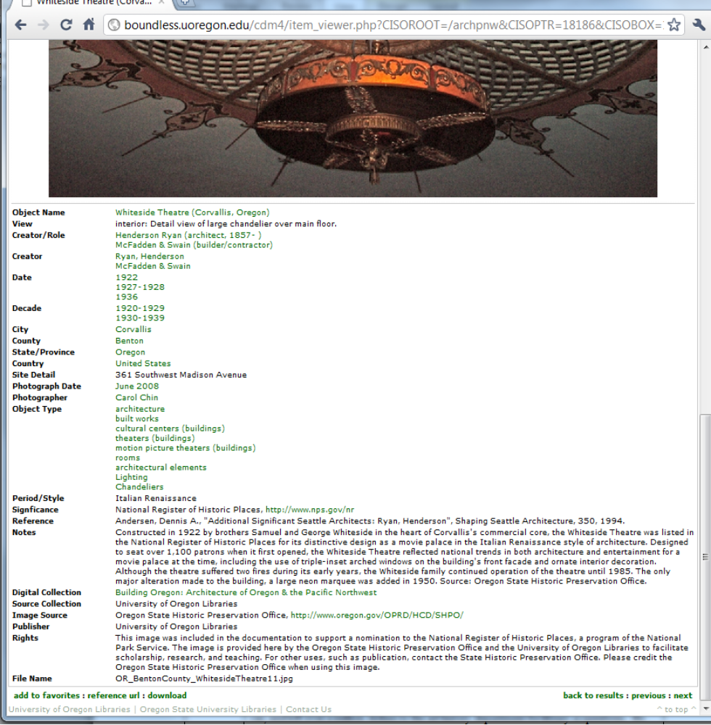
Oregon Newspapers Project
Index to the Portland Daily Abstracts
Ellis Lawrence Building Survey
Cultural Resource Inventories
SHPO Oregon Historic Sites Database
Sanborn Maps
Google Books
ancestry.com
Notes:
In January 2007, a breakthrough occurred. Jean Gillett, a 1939 graduate of the School, left in her will a large gift to the AAA Library, I obtained approval to use Gillett funds to pay for the digital outsourcing of approximately 14,000 slides, an effort which took place from October 2007 through the summer of 2008. Considerable content came from images created by Marion Dean Ross, Michael Shellenbarger, and Gilman Davis. The City of Eugene Preservation Office also donated approximately1600 slides. Grants to support the project came from the Architectural Foundation of Oregon and the MDR Chapter of the SAH. The majority of images and data came from the Oregon State Historic Preservation Office (SHPO). From 2000-05 Chris Sundt had obtained from SHPO duplicate slides of works added the National Register from Oregon. In August 2007, SHPO and I crafted an agreement (approved by UO Legal & the Libraries) whereby SHPO agreed to UO’s digitizing current holdings as well as future receipts. To date, over 8,000 images and documents in BO are from SHPO which has honored its agreement and quarterly sends about 200 images and national register documentation to be added to BO. By October 2007, Karen Estlund and I worked on the details of setting up the CONTENTdm collection. Building Oregon premiered in May 2008.
The original cataloging work in Building Oregon was derived from the slide cataloging which was output to spreadsheets and mapped to the fields set up in CONTENTdm with links to the images. This barebones legacy data has been continuously updated and augmented. Newer content not supplied by SHPO, from public domain images, has often required research since the image source usually provides minimal information. This is an unfortunate fact for architectural catalogers: few buildings have names. Instead they are commonly known by attributes: an owner, an address, a building type, and all of those attributes can change. Architects are rarely identified in regional architecture unless it is in architectural literature. By 1930, most street names and addresses in Portland had changed. Discovering and learning sources to identify or verify building information has strengthened my work as a subject specialist. Here are some sources routinely consulted. Several were created or digitized at UO.

Slide 8
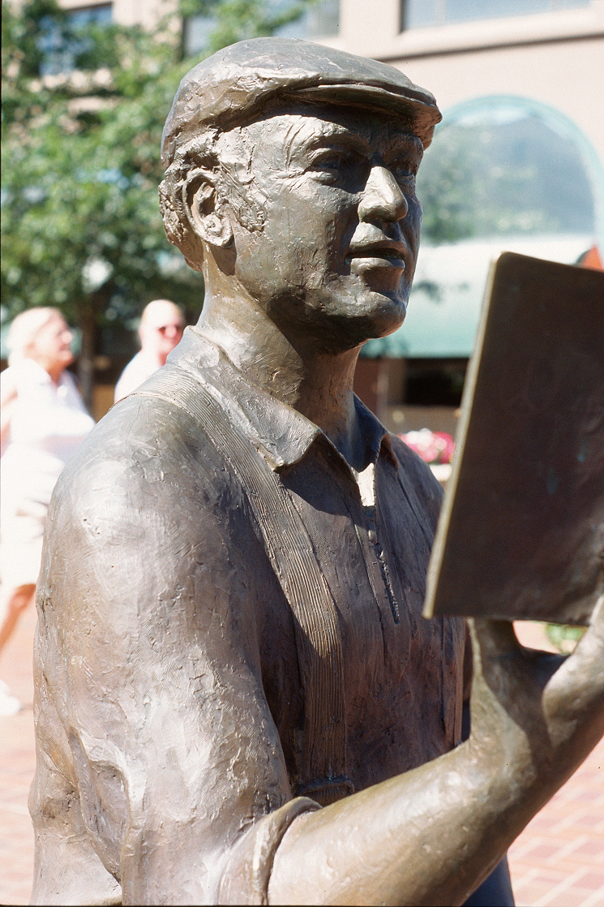
To hell with facts! We need stories!
Notes:
Well, this is Ken Kesey, as depicted in a downtown sculpture. As Kesey said, To hell with facts! We need stories! So I’m now going to let the pictures reveal some of the interesting stories living in Building Oregon.

Slide 9
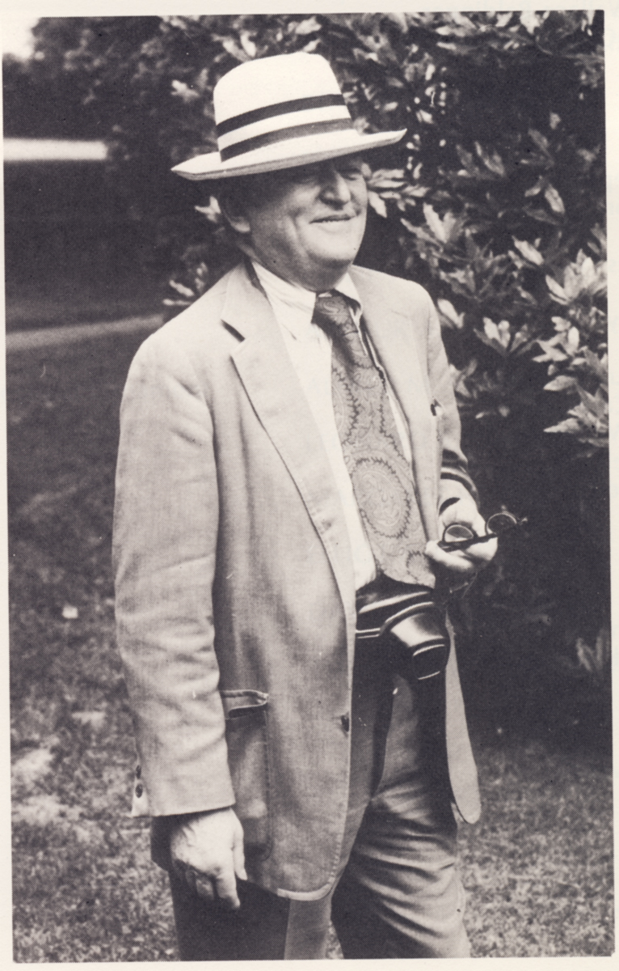
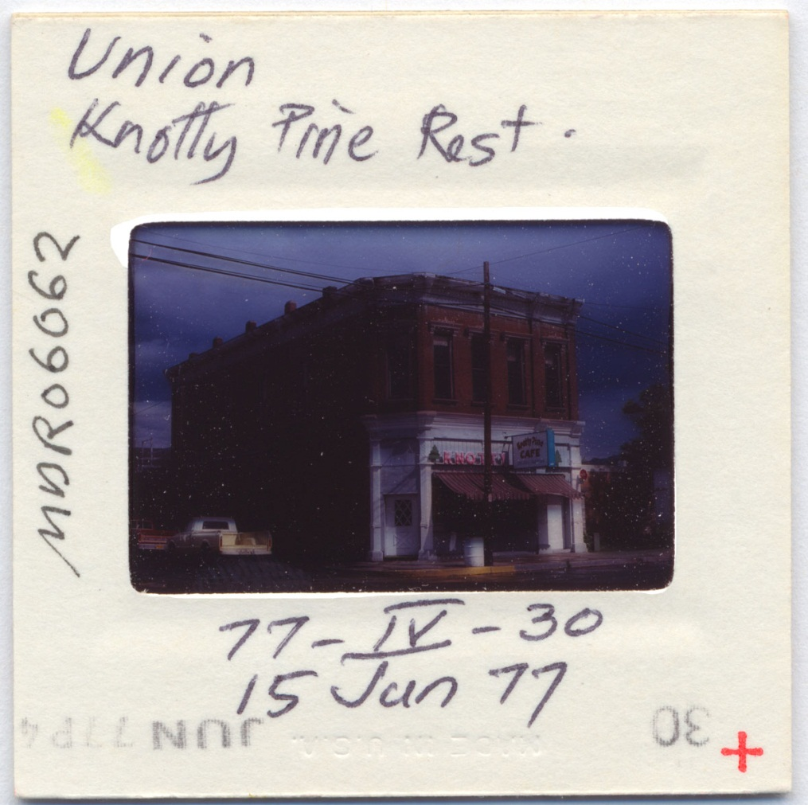
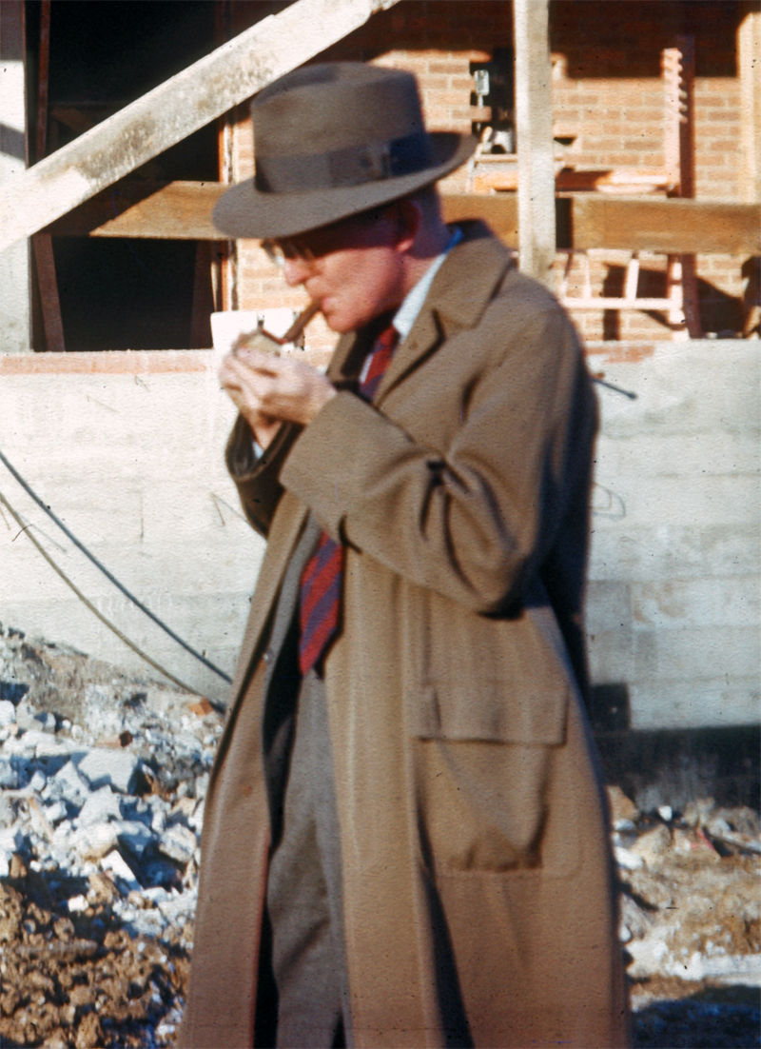
Notes:
My first selections show work by MDR and how he documented buildings over time. Here is Ross, an expert photographer. In addition to leaving us 35,000 slides upon his death, he left the Art History dept over a million dollars for library acquisitions. Unlike many, Ross carefully labeled, dated, and systematically filed his slides

Slide 10
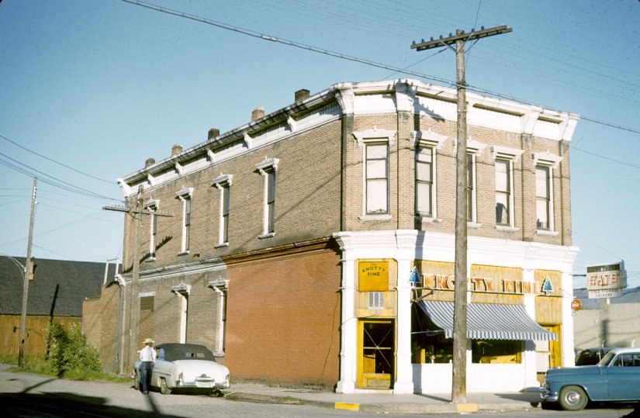
Notes:
Here is Knotty Pine Restaurant in 1954 and in 1977. Ross did not have easy access to the resource we know have, so didn’t know the proper name for this building. To catalog this building, I went to the OHS database to see if I could track it down. Since Union is quite small, I used google maps to scan for some candidates.

Slide 11
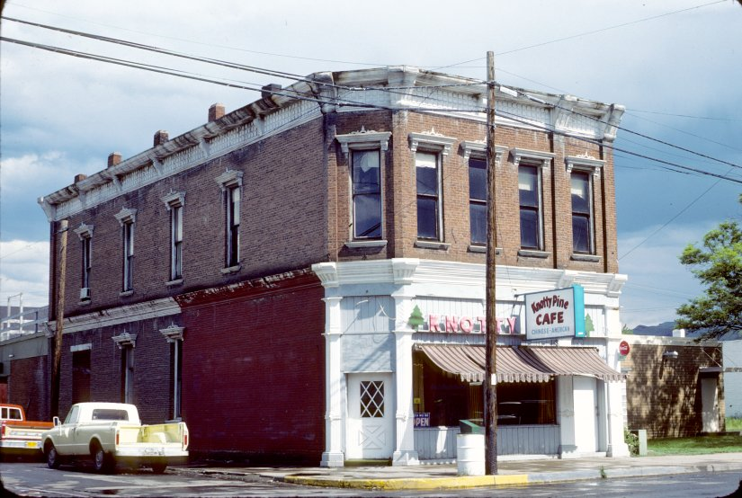

Slide 12
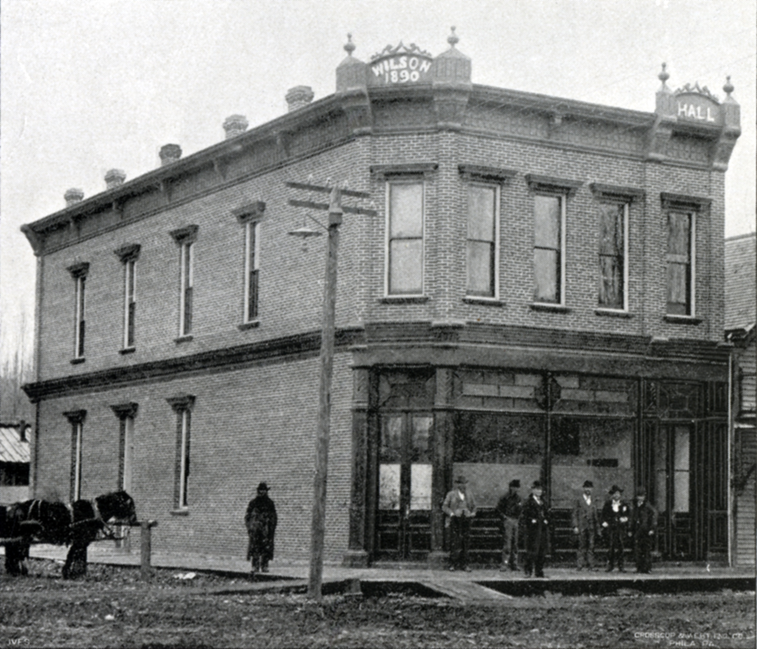
Notes:
By pure serendipity, I happened to look through the an 1892 photographic survey published in commemoration of the Oregonian’s new building. I came across a picture which matched a google maps image and was able to correlate with the Oregon Sites address. The entry has been revised to read Wilson Block.

Slide 13
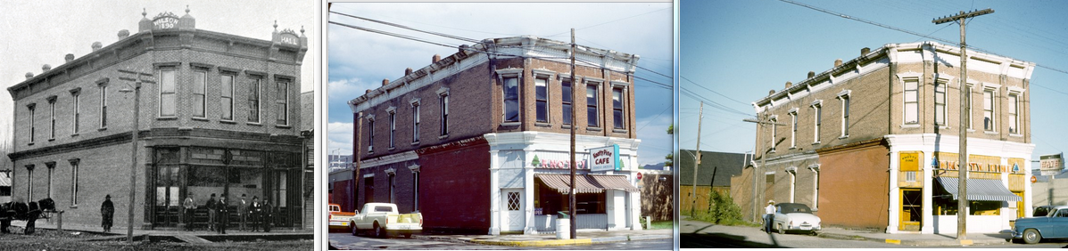

Slide 14
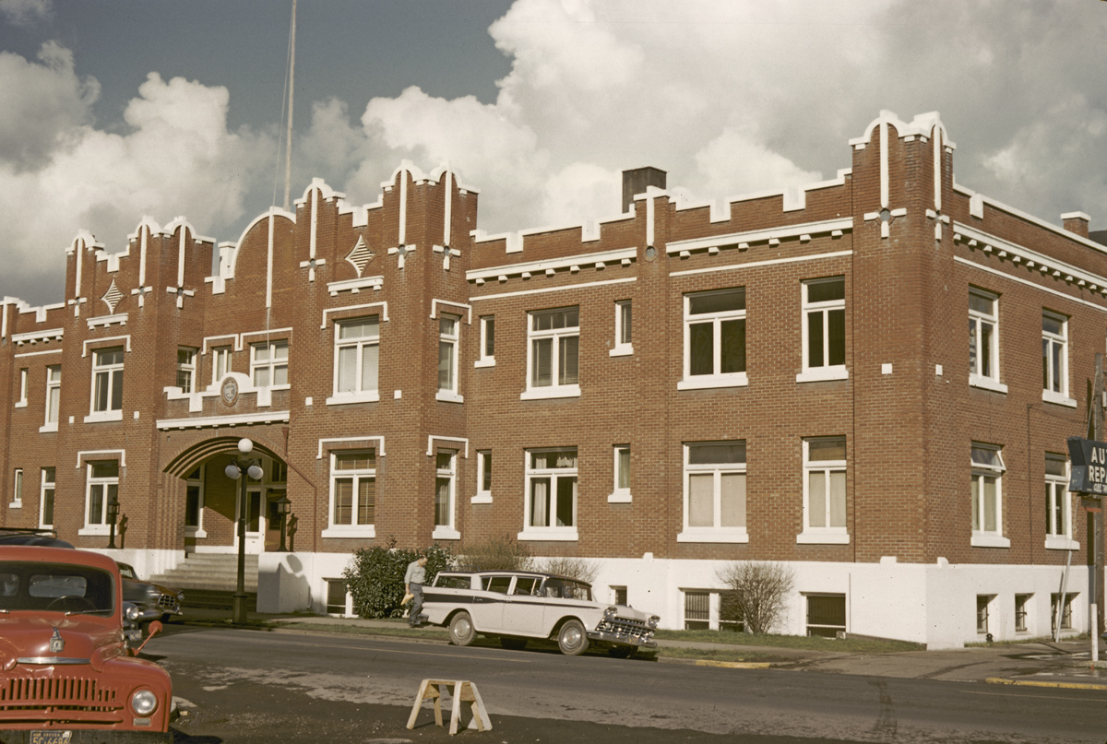
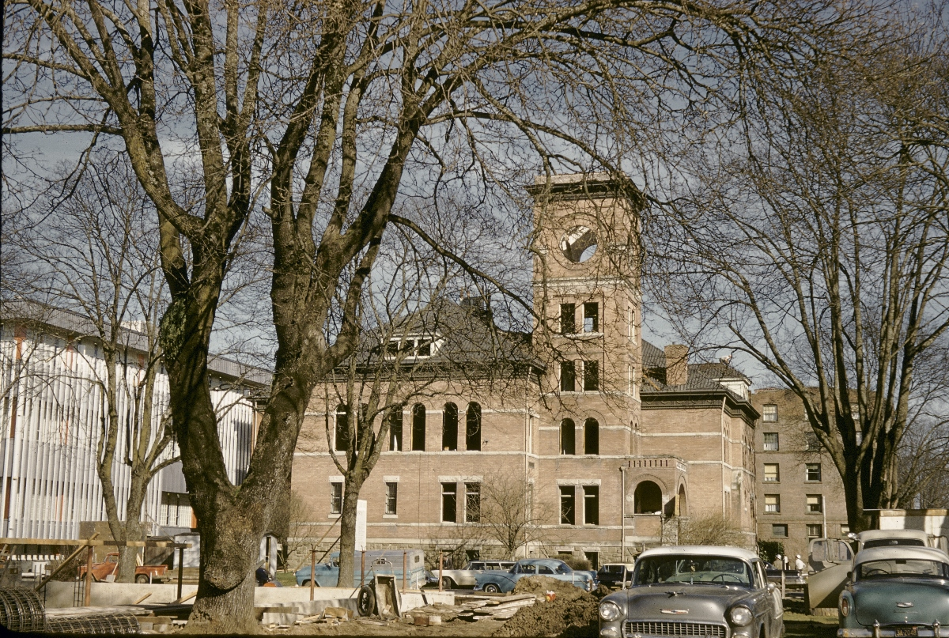
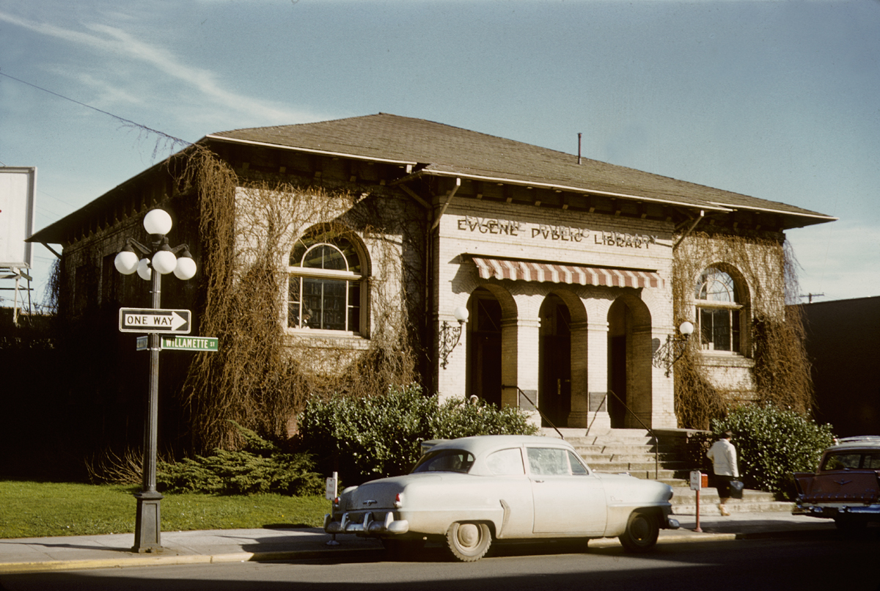
Notes:
The Wilson Block has survived but many buildings represented in BO no longer exist. Eugene is a prime example of a city insensitive to its past. Here once existed the state’s first Carnegie library who also designed UO’s first library the same year, 1906; an armory (1914-76); and the county courthouse (1890-1959).
Ross photos, c 1959

Slide 15
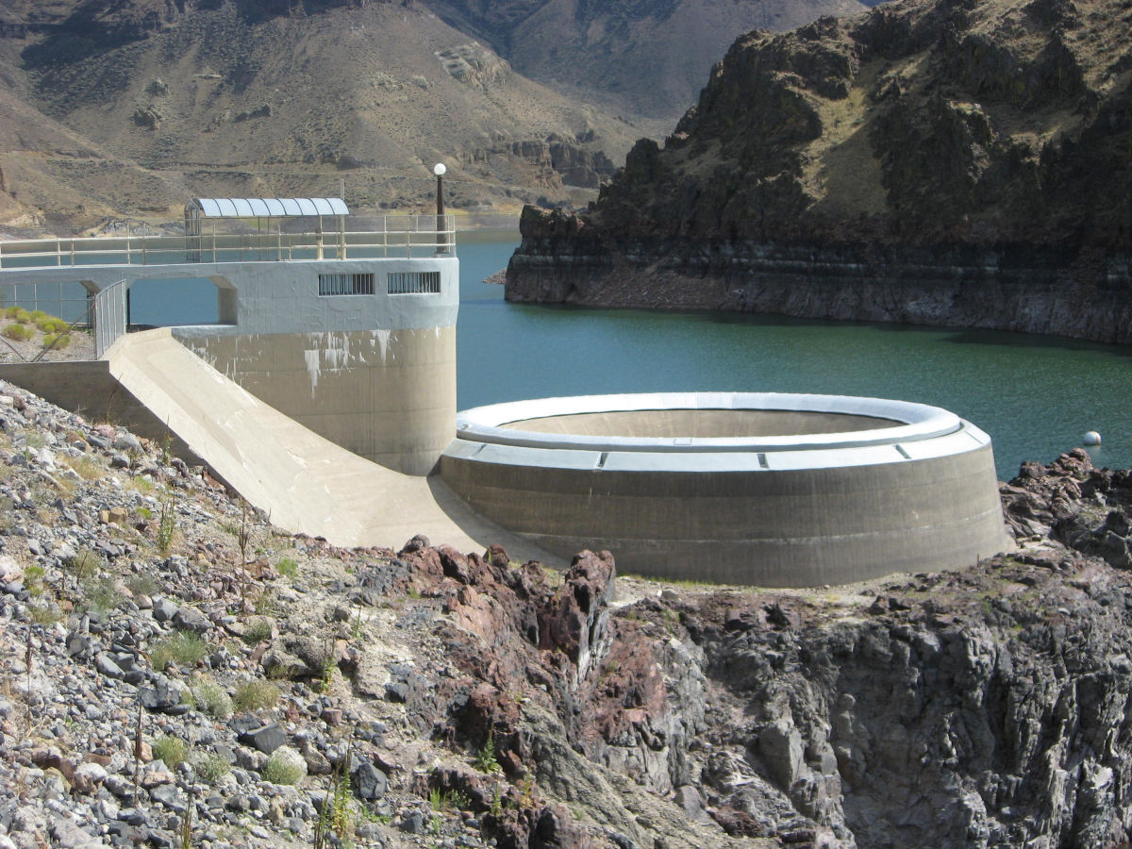
Notes:
Content Variety in Building Oregon
Among the living in BO are interesting works especially provided by SHPO whose definition of historic site goes well beyond architecture. This structure is part of the Owyhee Dam complex, Malheur Co., built 1927-32. The dam was a testing ground for new construction technology later used at Hoover Dam and elsewhere.

Slide 16
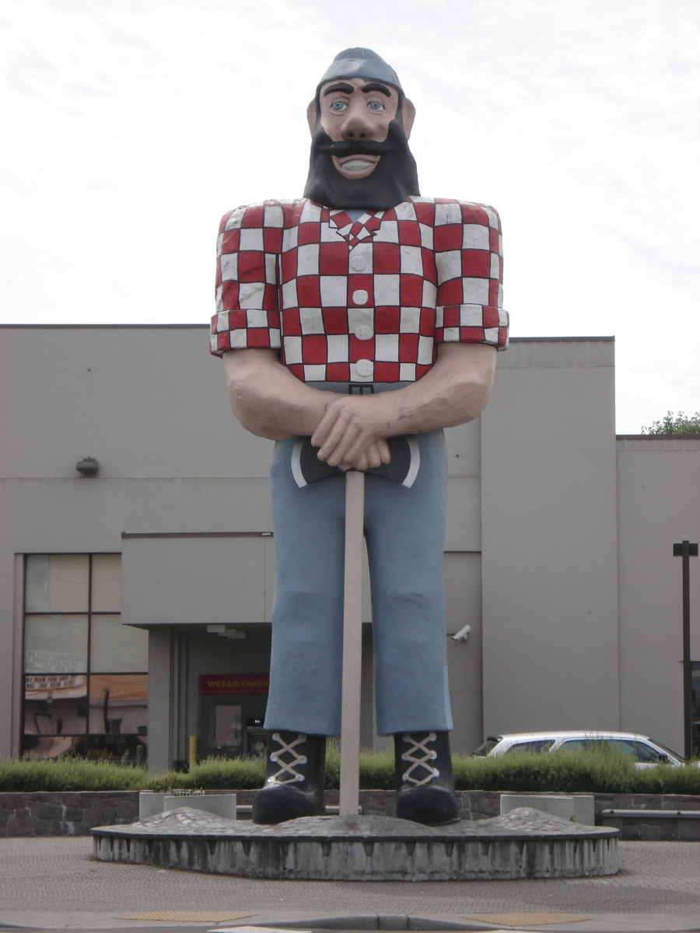
Notes:
Paul Bunyan, an outstading example of a roadside attraction, was created in 1959 as part of festivities celebrating the Oregon Centennial Exposition. According to its documentation, no other mythical character is portrayed more often statewide.

Slide 17
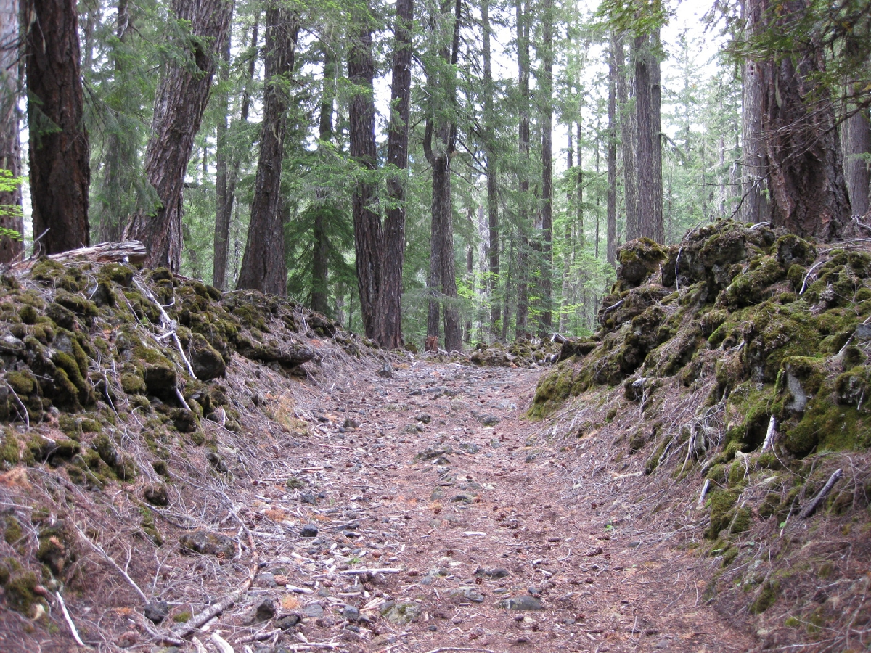
Notes:
This road cut through lava is part of the Santiam Trail. The Santiam Wagon Road opened in 1866 and was viable until 1920. It is listed in the NR for its role in helping connect Oregon’s regions divided by the Cascades and for changing Oregon’s settlement patterns.

Slide 18
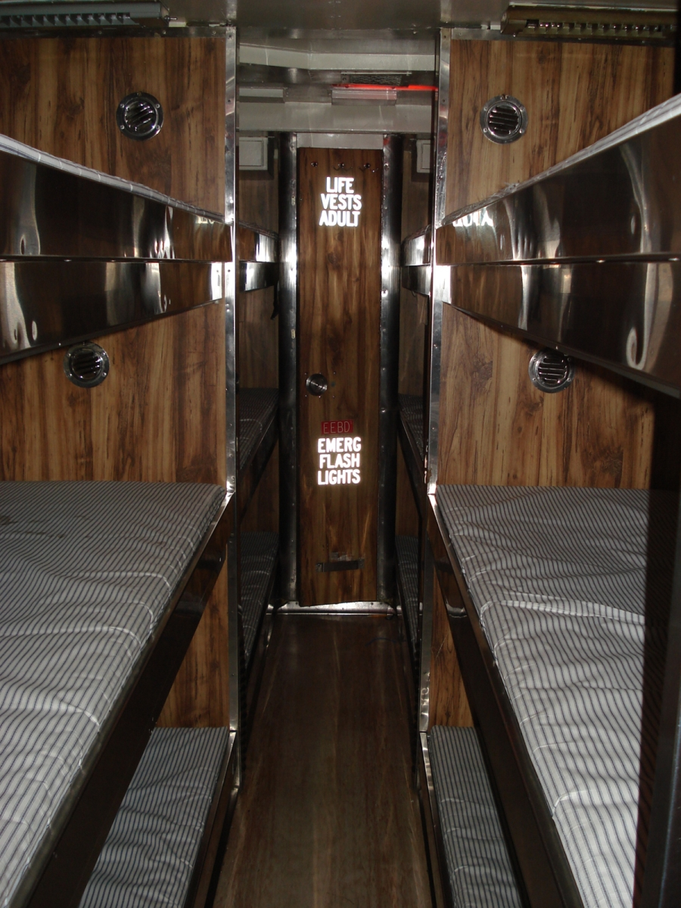
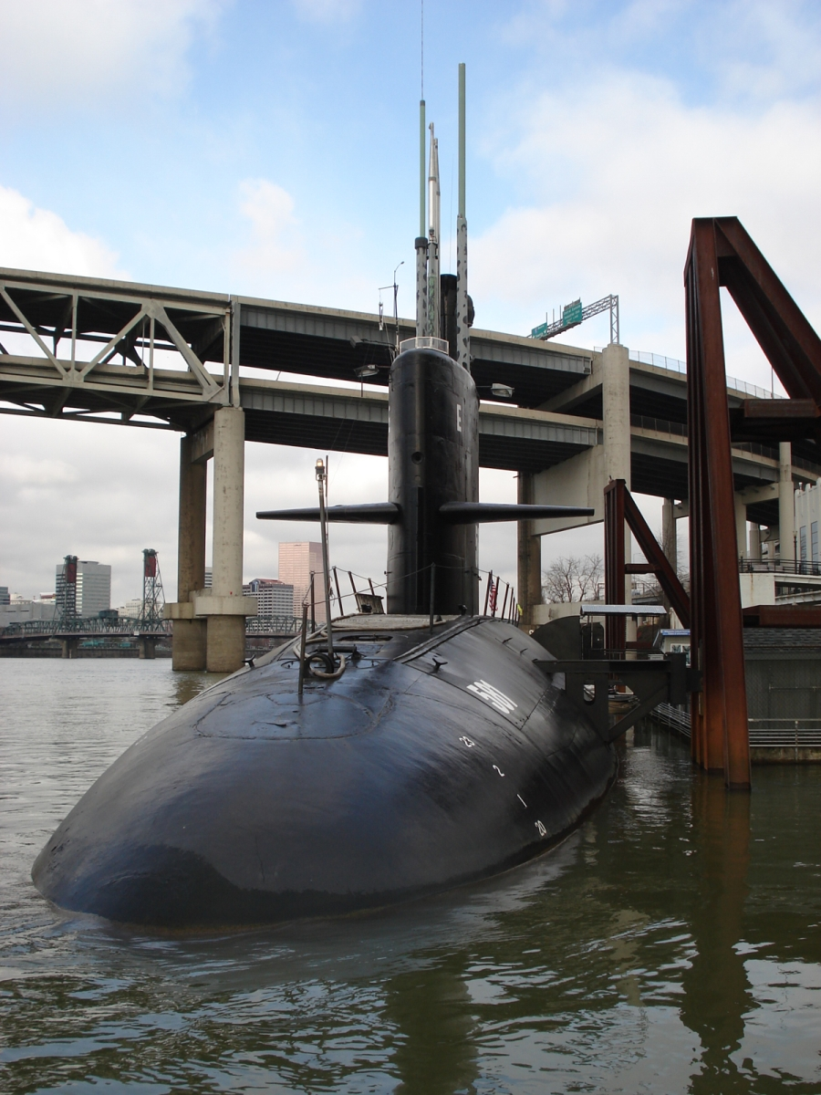
Notes:
The submarine USS Blueback, now stationed at the OMSI, was commissioned in 1959 and is significant as the last surviving example of a diesel submarine. This submarine starred in the film The Hunt for Red October.

Slide 19
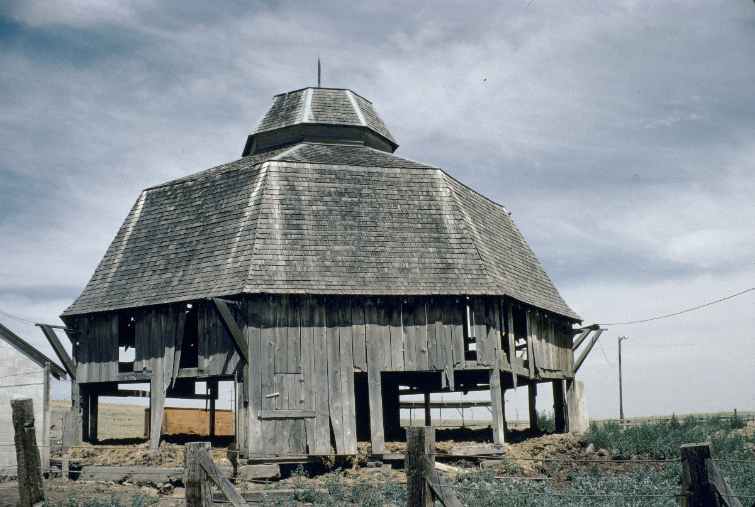
Notes:
This hexagonal barn at Simnasho, Wasco Co., is representative of the photography of C. Gilman Davis who was interested in vernacular architecture and signage.

Slide 20
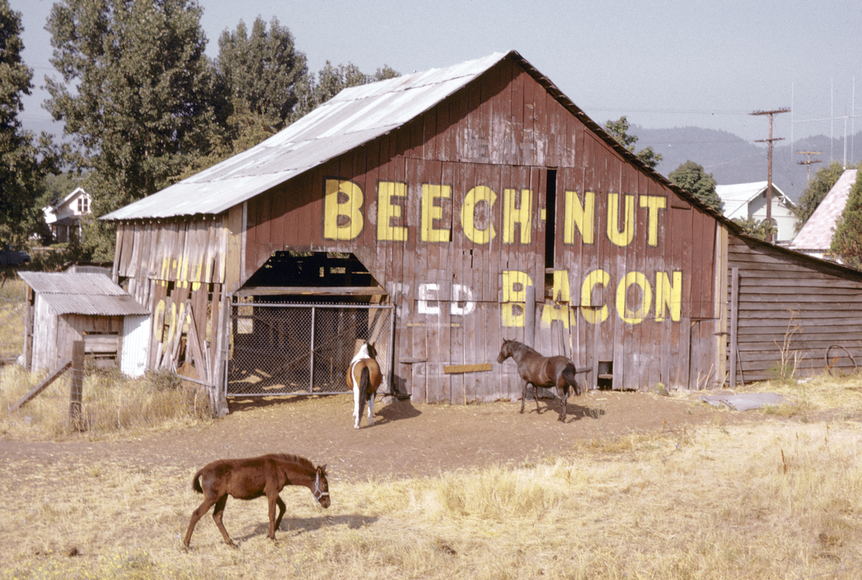
Notes:
Barn with sign, C. Gilman Davis, 1976

Slide 21
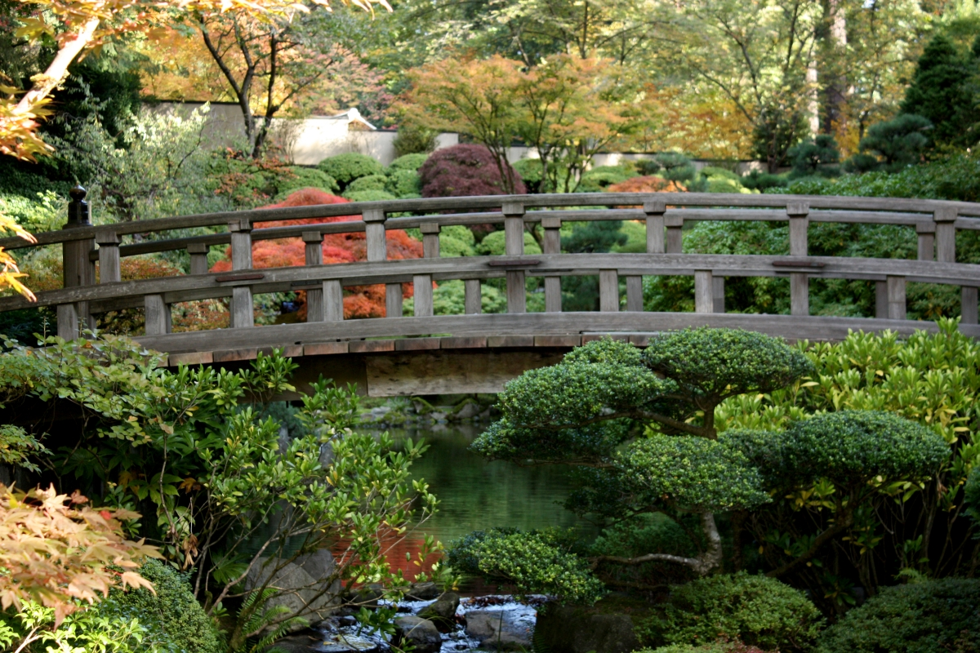
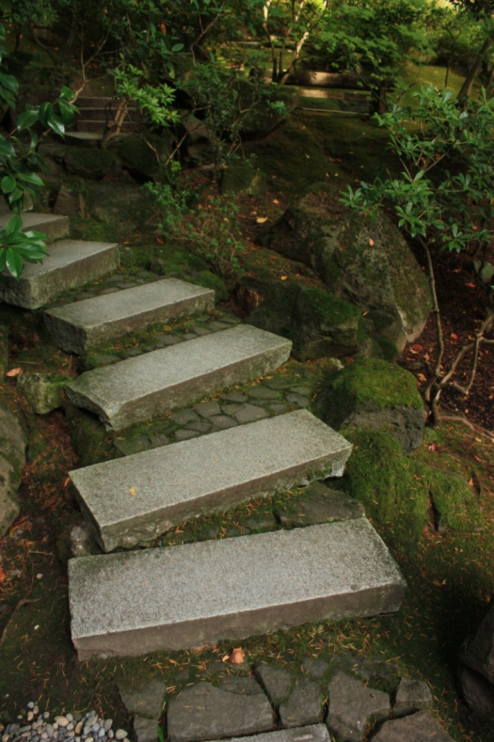
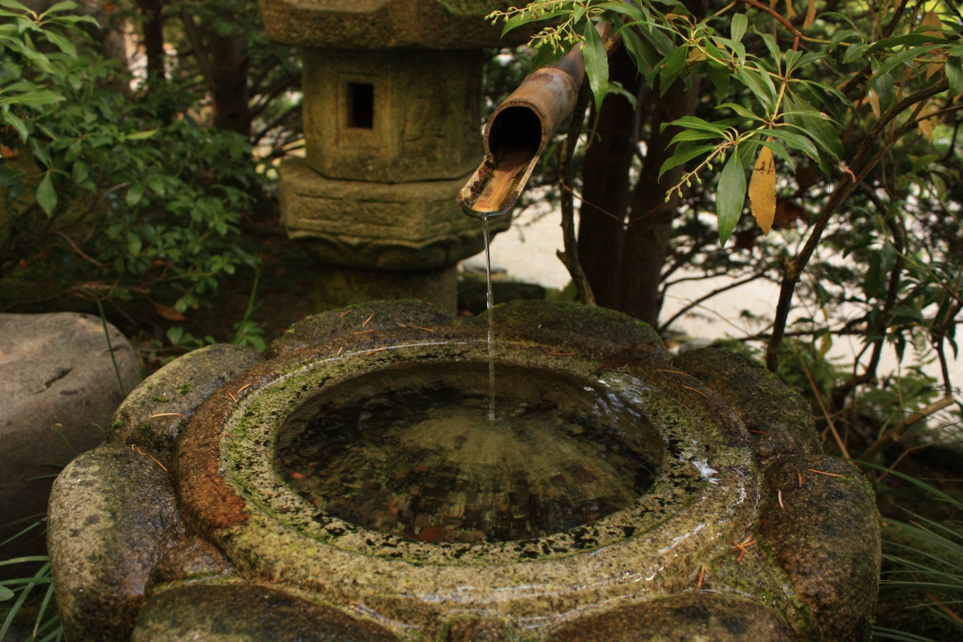
Notes:
From agricultural sites we go to gardens, here the Portland Japanese Garden created in 1963.

Slide 22
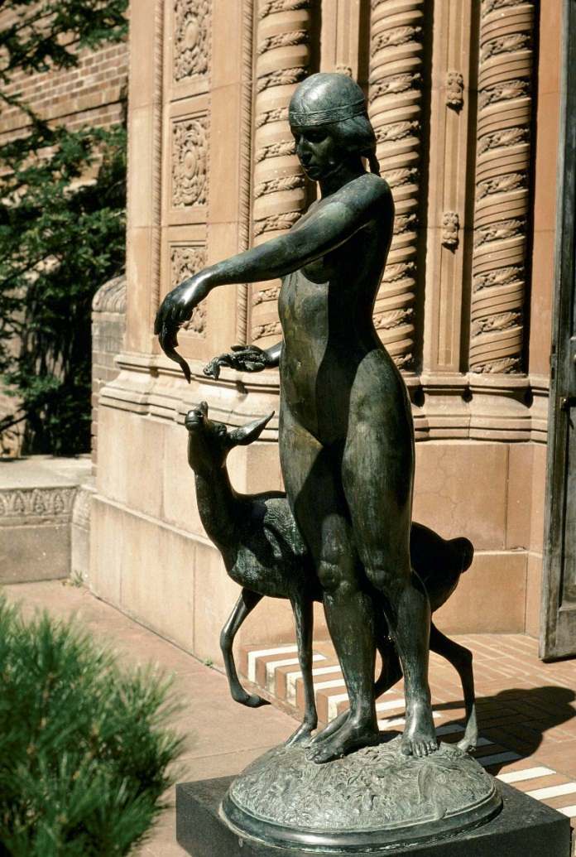
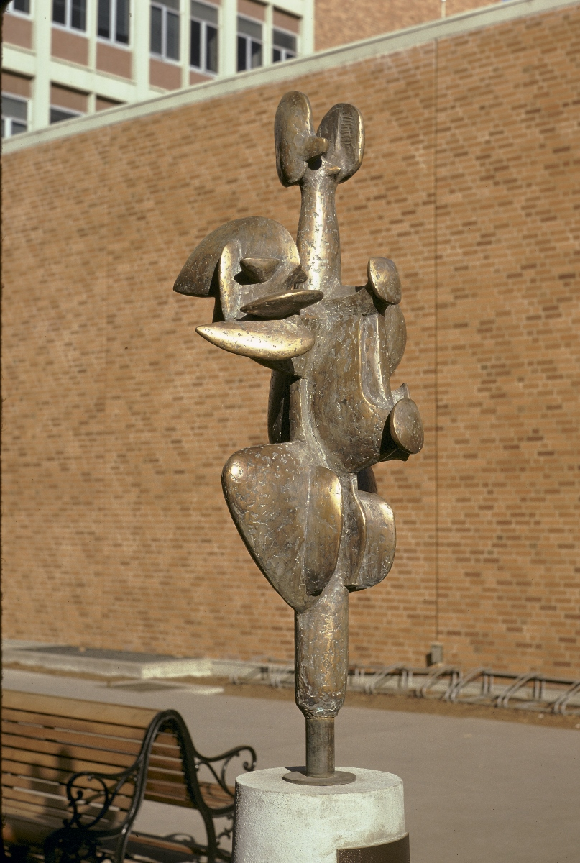
Notes:
BO has about 350 images of sculpture. Two represented here tell tragic tales. The Indian Maiden by Phimister Procter (1930) was vandalized; now inside museum. The Falconer (1967) by james Lee Hansen, was stolen last year.

Slide 23
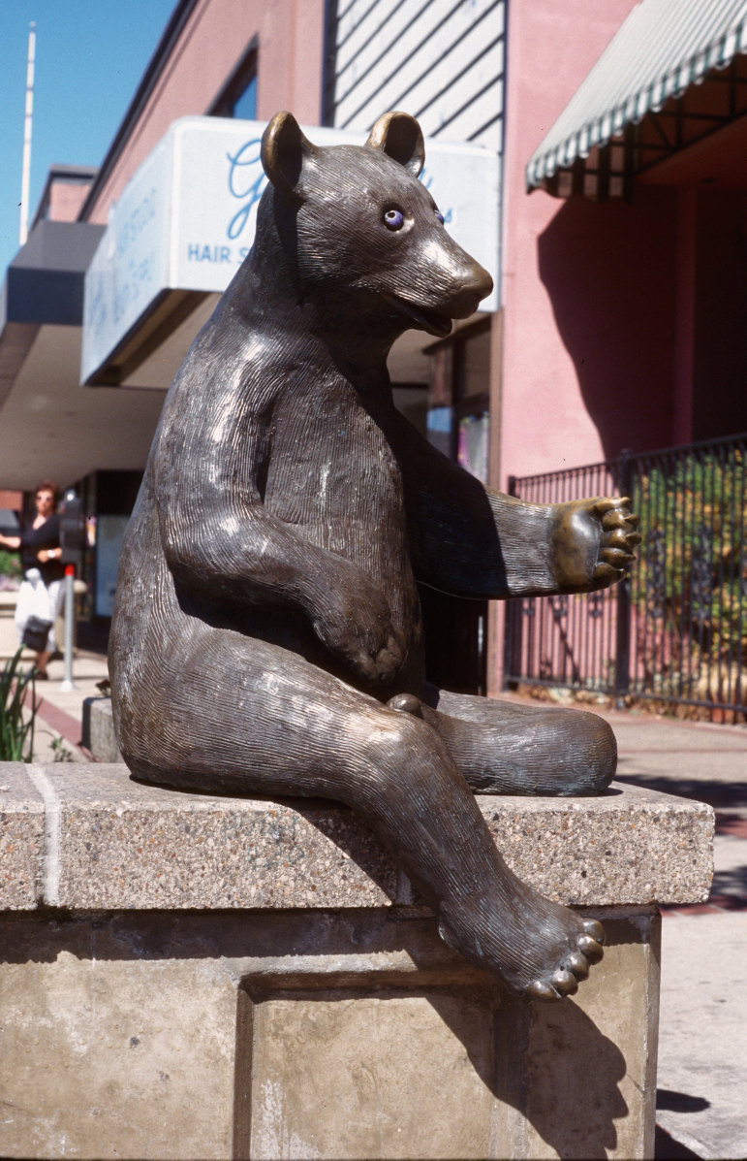
Notes:
This bear, who appears quite unhappy, is being unceremoniously transported to MNCH where it will be affixed to the exterior. By Wayne Chabre 1988.

Slide 24
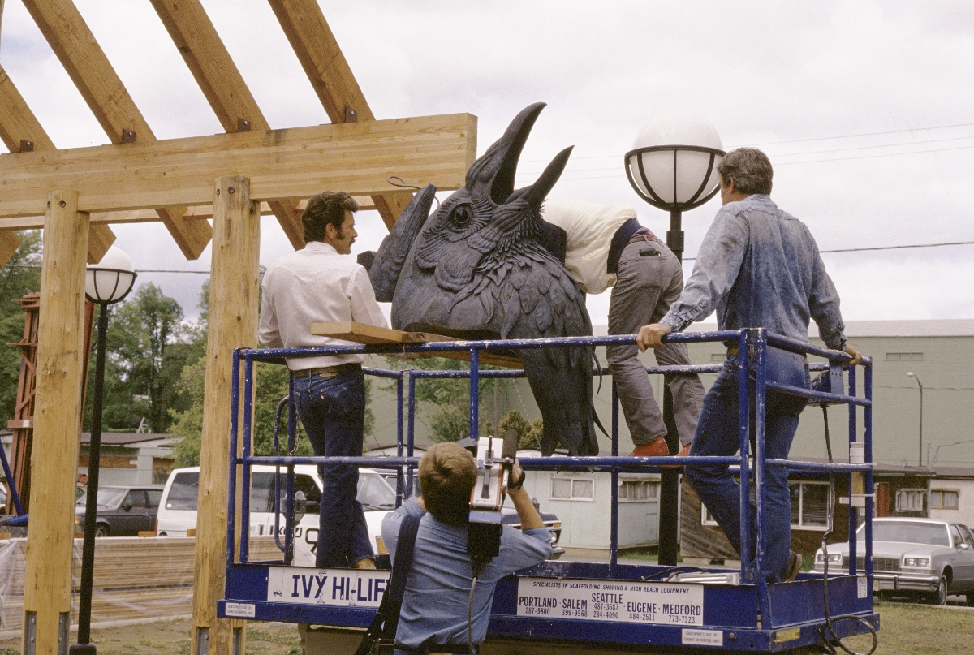
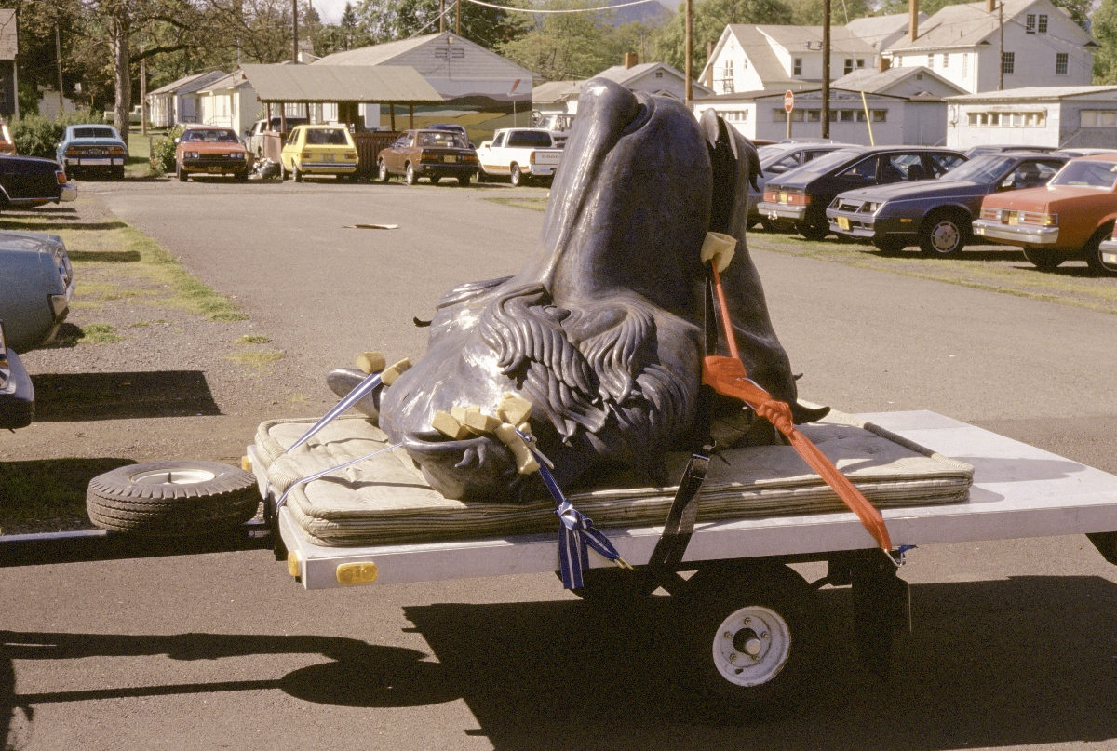
Notes:
Her companion, the raven, seems even more distressed. The raven, bear, and salmon figure prominently in NW native American stories and rituals.
Her companion, the raven, seems even more distressed. The raven, bear, and salmon figure prominently in NW native American stories and rituals.

Slide 25
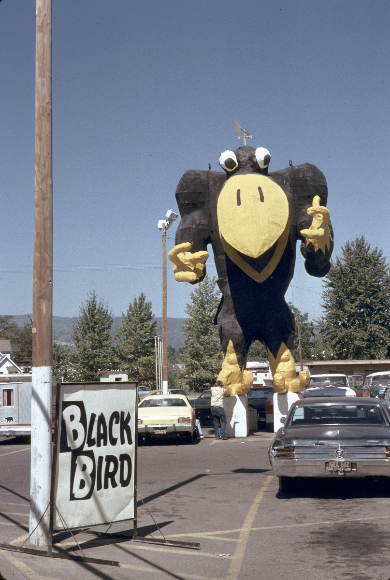
Notes:
This blackbird, photo by Davis, Medford, 1974, is a scientist at heart. There’s a weathervane on top of his head.

Slide 26
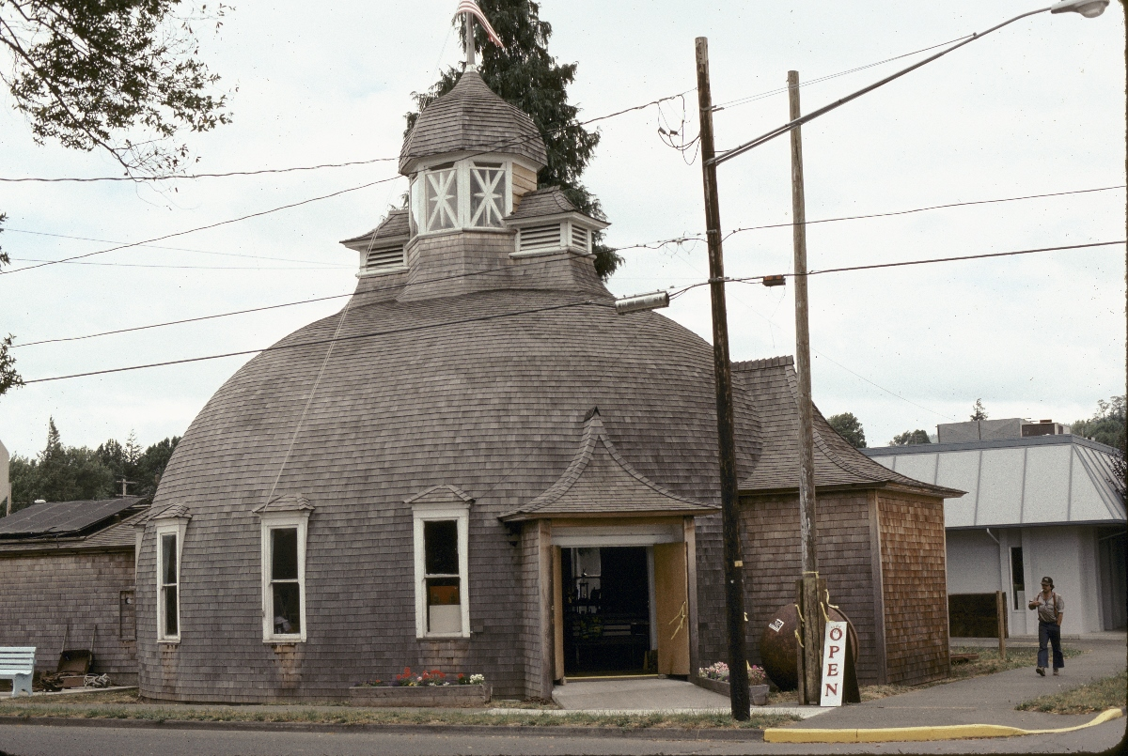
Notes:
The variety of religious structures in BO reflects Oregon’s religious diversity. This work was originally a Mormon temple, patterned somehow after the great temple in Salt Lake City. It is now a logging museum in Coos Bay.

Slide 27
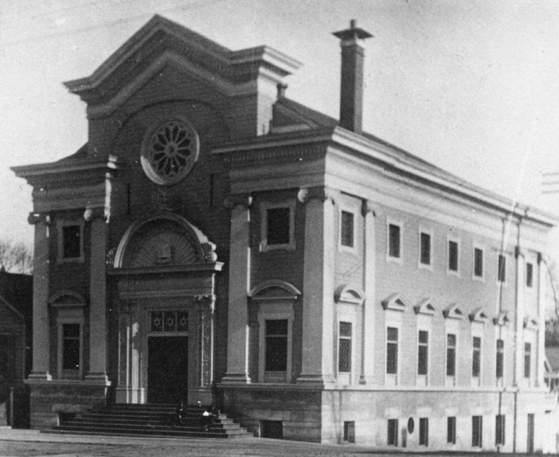
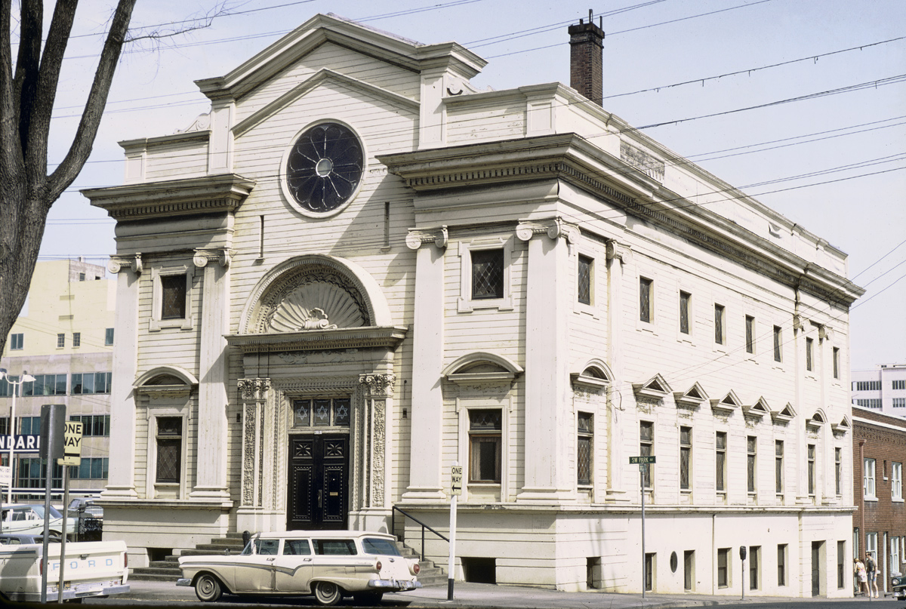
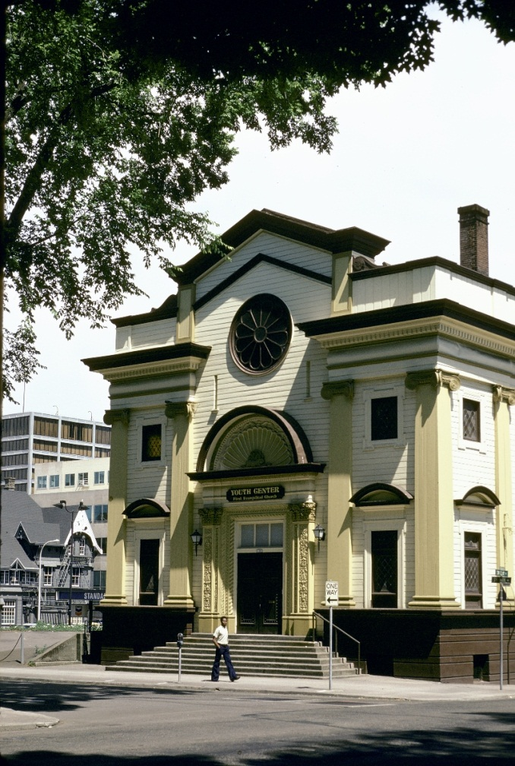
Notes:
This beautiful synagogue by Edgar Lazarus was a Christian Church in the 1960s when this photo was taken by MDR. We also have other incarnations of this building.

Slide 28
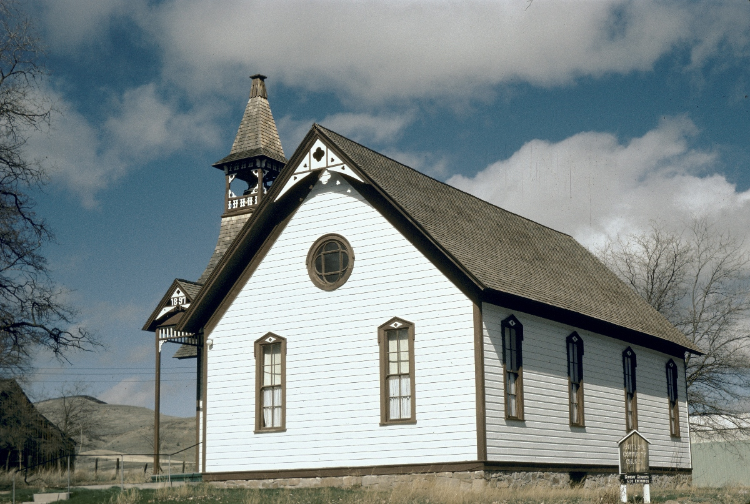
Notes:
This charming 1897 church is in Antelope Oregon. In 1984 this historic town of about 50 was known briefly as Rajneesh. It had come under the control of the followers of Bhagwan Shree Rajneesh who lived in the nearby intentional community, Rajneeshpuram.

Slide 29
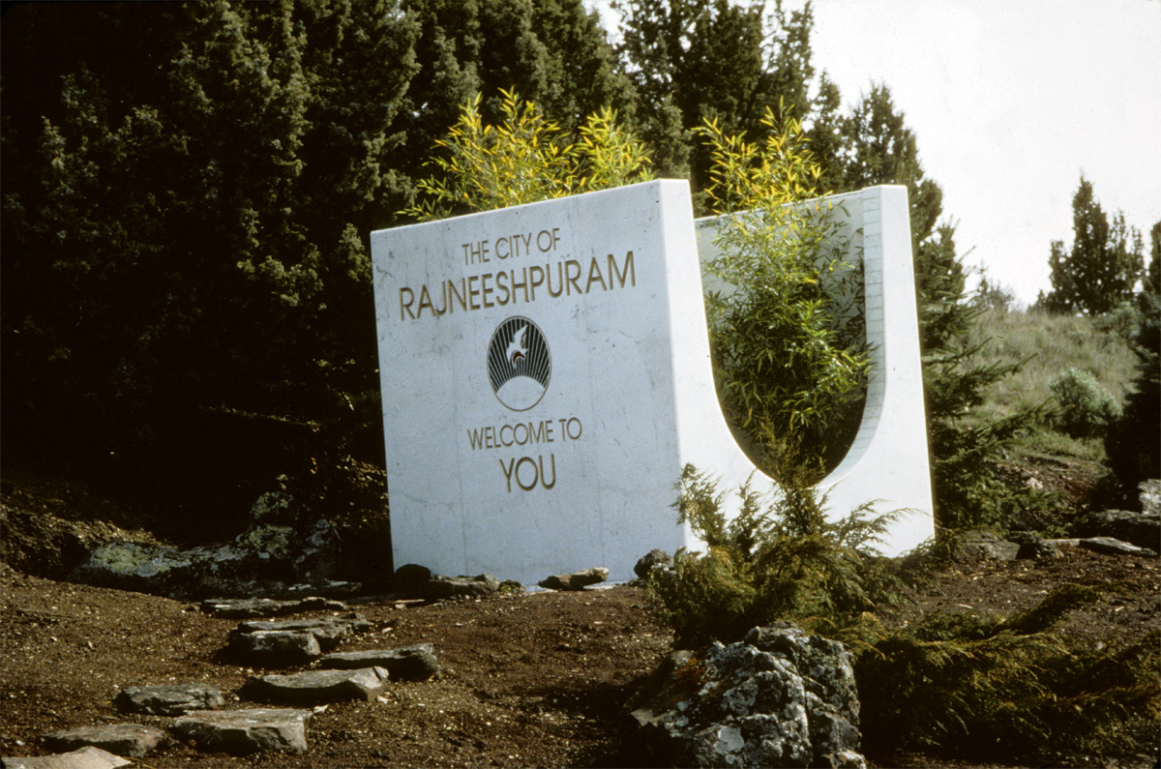
Notes:
Welcome to Rajneeshpuram

Slide 30
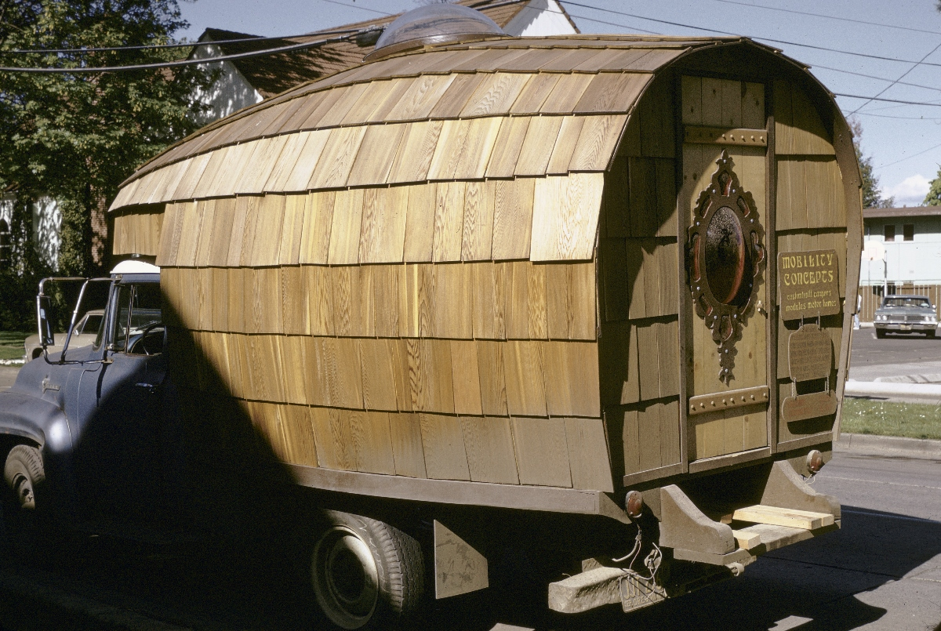
Notes:
There is a wide range of housing types in BO. Preservationist Michael Shellenbarger was interested in construction technology, and this home on wheels made clever use of shingles and a domed skylight in 1990.

Slide 31
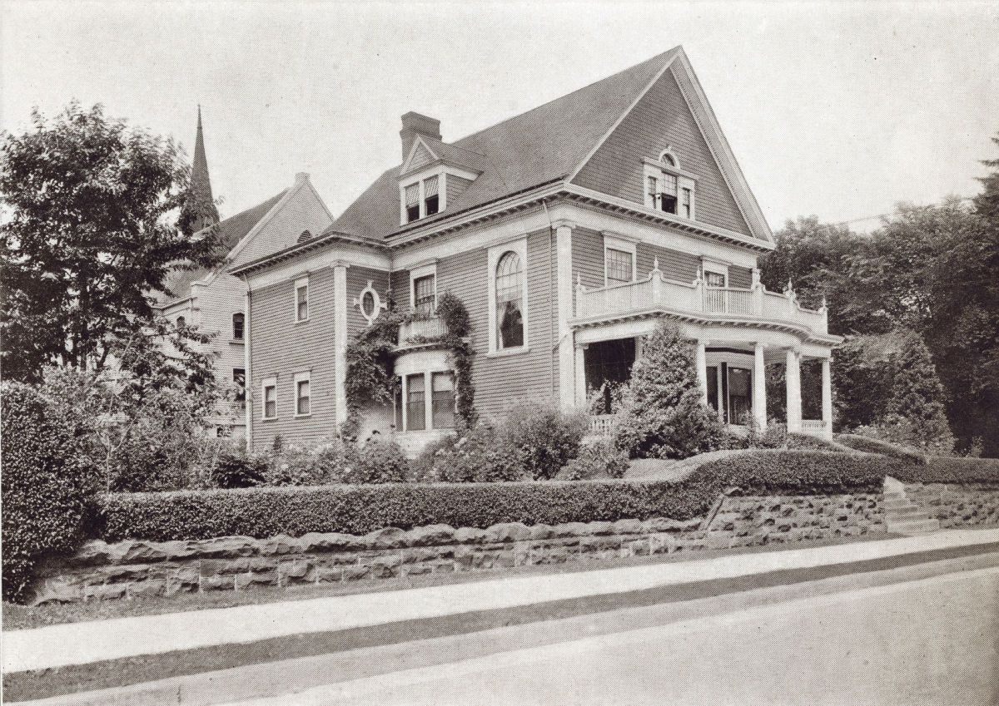
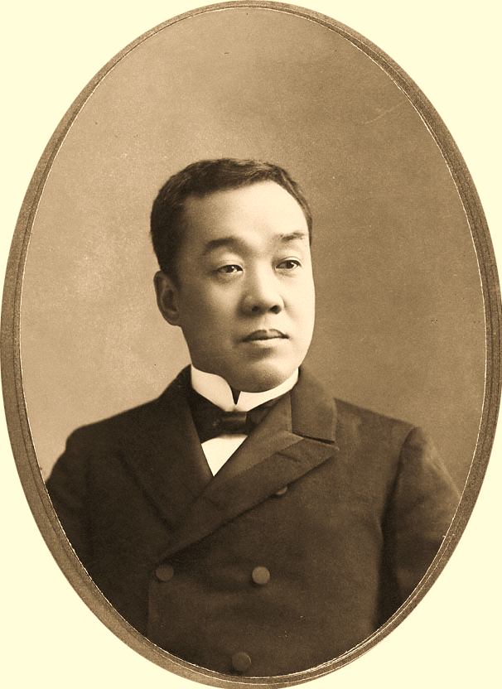
Notes:
I’m often looking for pub dom content to add to the collection. This house appears in the book, 1911 Residential Portland, which provides 80 images of prominent homes. Each image has a caption giving brief owner’s name and address but no architect. This house was cited as the residence of S. Ban with a street address . Not a typical name in BO, I discovered in researching this work that the owner was Shinzaburo Ban, a successful Japanese businessman with diverse interests in Oregon from 1890s to 1920s . That information comes from the Oregon History Project. Mr. Ban was forced to leave Oregon in 1926 because of the state’s 1923 Alien Land Law which forebade noncitizens from owning/leasing land.

Slide 32
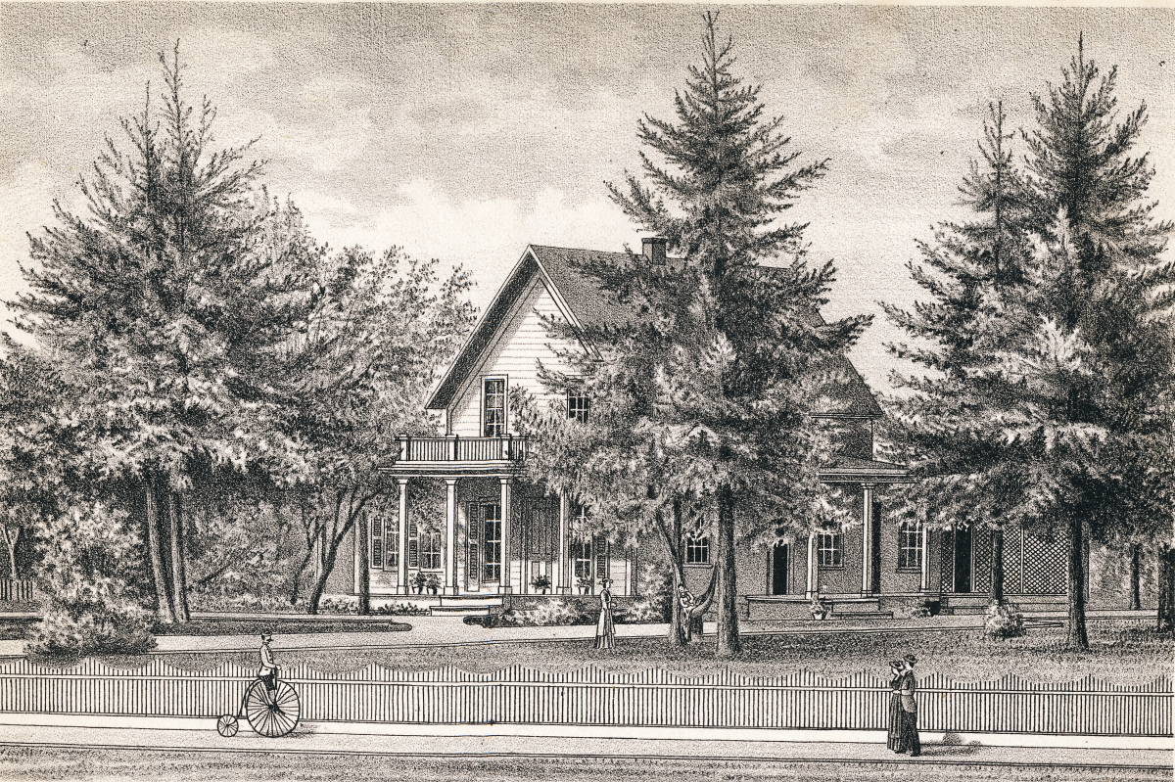
Notes:
Among Eugene’s houses, here we see the homestead of A. W. Patterson scanned from the IH Lance County of 1884. Patterson was a doctor and a surveyor. He laid out the town of Eugene in 1854 and as a state senator played a key role in bringing the UO to Eugene. He later moved to a grander home on 12th Street. This house was home to a fraternity from the 1950s onward. MDR photo 1974. The house fell into disrepair but before its destruction. But before it disappeared it had a starring role in a movie. This the Animal House.

Slide 33
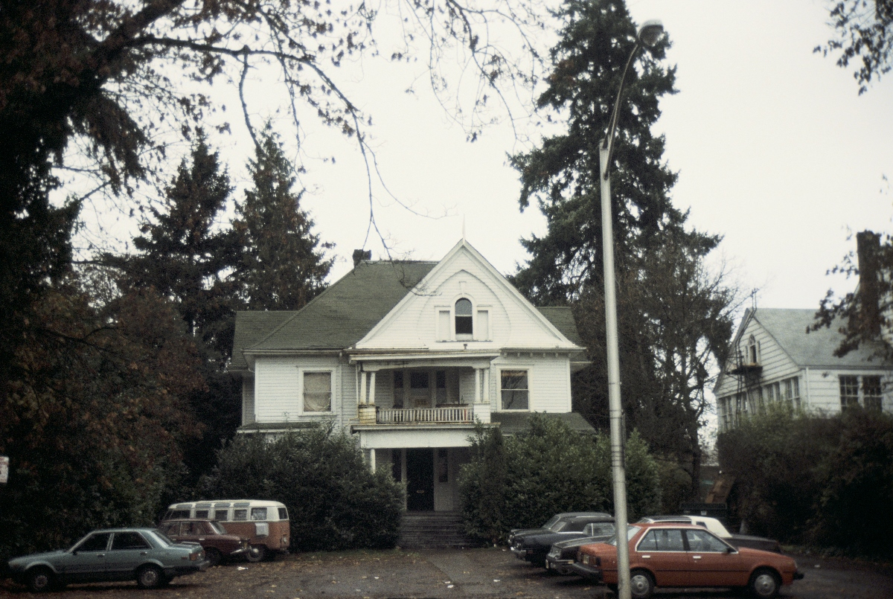
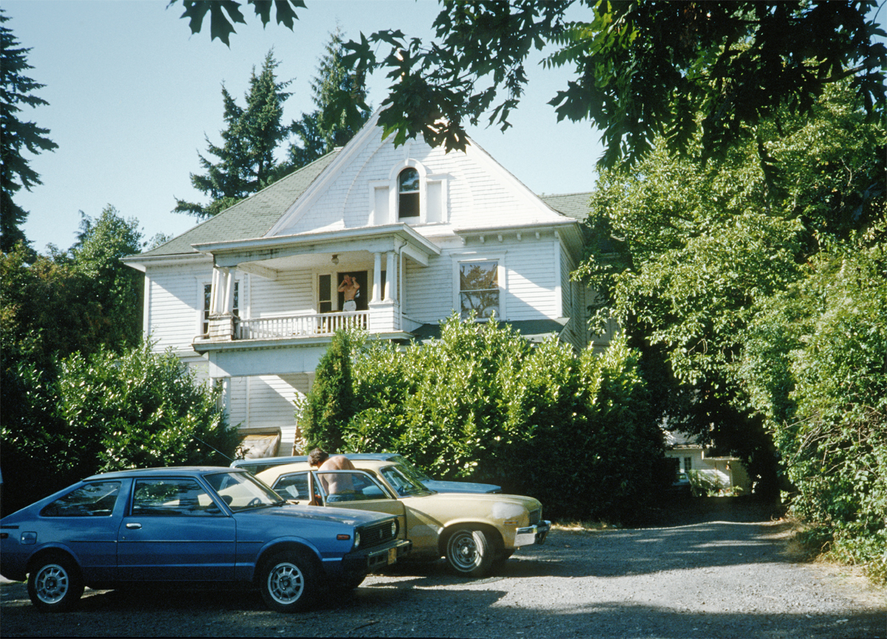

Slide 34
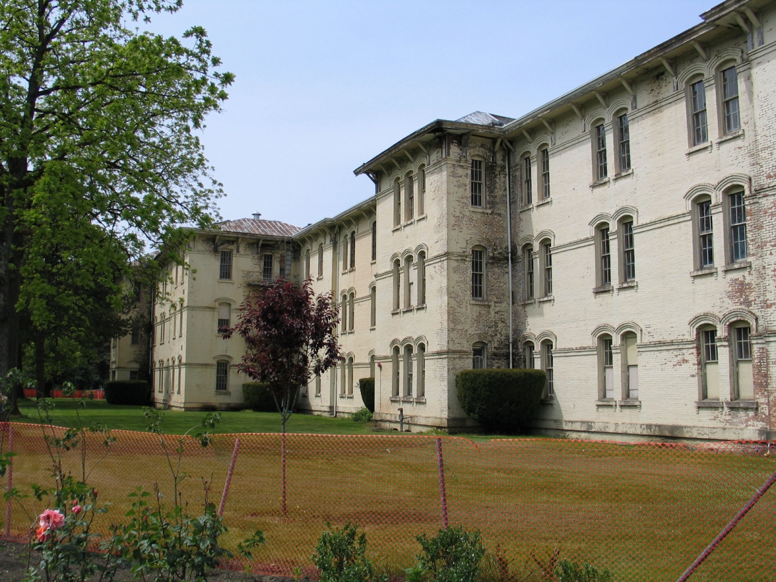
Notes:
Another Oregon work important in film history is building from the complex originally named the State Asylum for the Insane. This building, destroyed in 2003, was used in the film adaptation of Ken Kesey’s One Flew over the Cuckoo’s Nest”.

Slide 35


Notes:
We conclude with a return to Kesey Square in downtown Eugene. Its centerpiece is the sculpture named The Storyteller by James Helzer which shows Kesey reading to children. I’m particularly drawn to the expression of this young man who appears simultaneously attentive , questioning, if not rebellious.

